Slide 1
Mobility R&D in Luxembourg
Towards green, connected and automated mobility

Slide 2
Luxembourg AutoMobility Cluster
  50 companies
  2 OEMs
  component suppliers
  connectivity & smart mobility service providers
  Research
  University of Luxembourg
  2 public research institutes
  Sales turnover
  ~ €1.5 bn
  Additional turnover
  > €2.5 bn (equivalent) related to Luxembourg-based R&D cost centres
Staff
10,000 employees
of which 20-25% international R&D professionals
“Powered” by German, French and Italian automotive experts
Talented professionals, international and highly skilled

Slide 3













Well-known global players
Examples

Slide 4
… almost 50 automotive companies in total
Accumalux
AECT
Airtech
Amova
ArcelorMittal
Ateel
Brace Automotive
CEBI (Elth)
Circuit foil
Clean Carb
Codipro
Delphi
Dometic
DuPont
Eurocomposites
Examotive
Fanuc
Faurecia
FB Consulting
Goodyear
Carlex
Hitec
HUSKY
Hydro Aluminium
Hyosung
IAC
IEE
KATCON
KYMCO
LIST
Luxcontrol
LuxMobility
Mahle
Motion-S
QED
Raval Europe
Rotarex Automotive
SAIC
SDAAC
Siemens
SES
SNCH
SnT
Technofibres
Textilcord
TERALINK Solutions
U-Jet
University of Luxembourg

Slide 5
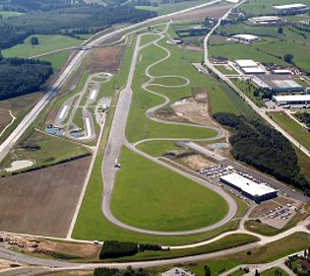
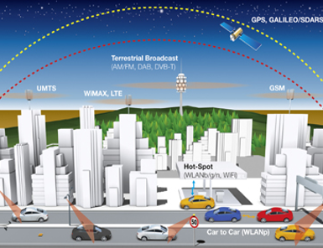
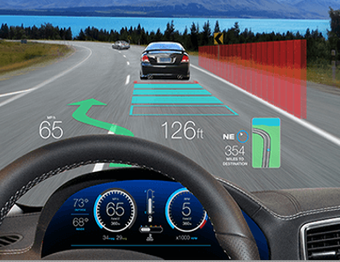
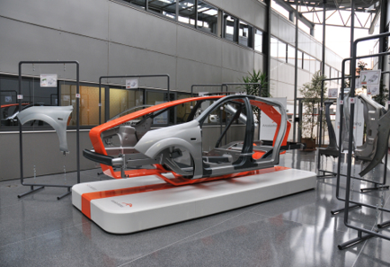
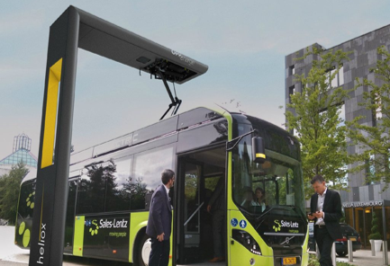
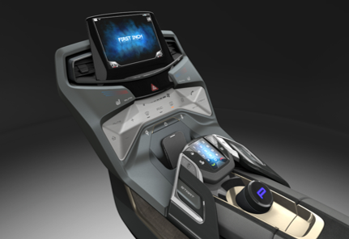
Coverage of all major key competences
Vehicle dynamics
Connectivity & mobility services
ADAS – automated driving
Chassis & body
Powertrain (engines, BEV, HEV)
Comfort & Convenience – HMI

Slide 6
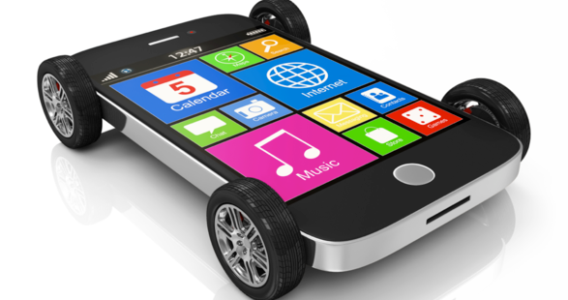
Innovation & new business development
Luxembourg growth strategy
#1 Decarbonization of transport
#2 Connectivity, digitalization, automation

Slide 7
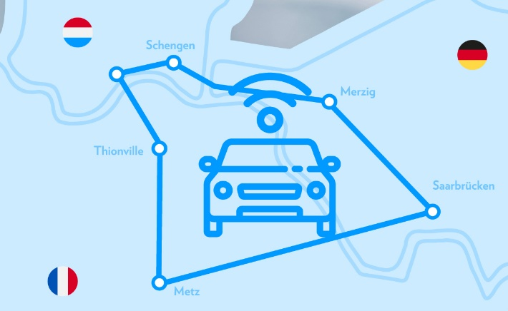
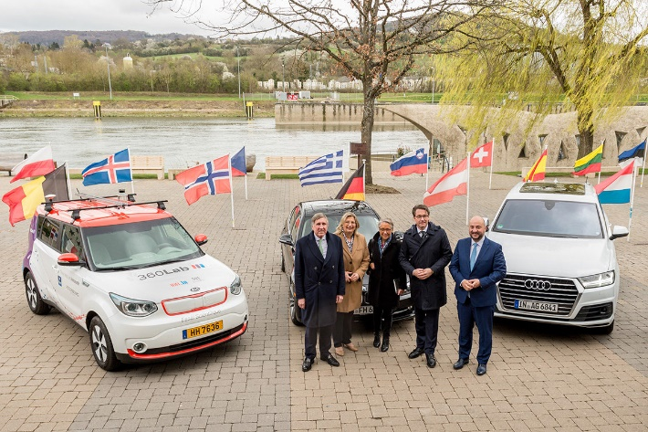
Automated driving
Digital cross-border testbed LU-DE-FR
  Development, testing and validation of automated driving vehicles and next generation C-ITS technologies
  Uninterrupted cross-border connectivity supported by cellular network, vehicular wifi (G5) and satellite communication
  Launched in April 2019 in Schengen with the presence of 5 ministries from France, Germany and Luxembourg

Slide 8
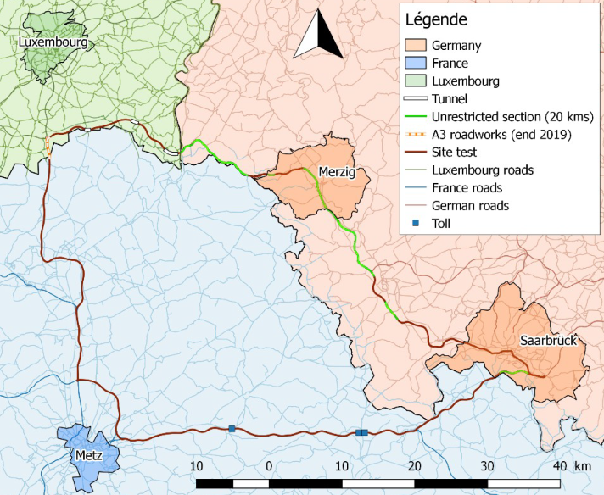

Automated driving
Digital cross-border testbed LU-DE-FR
Compatibility of automated driving vehicles
LU
DE
Connected and automated driving
Distance totale: 215km
Impact and effects of future mobility
FR
Big Data enabled applications
First awarded projects: 5G-CROCO & TERMINAL

Slide 9
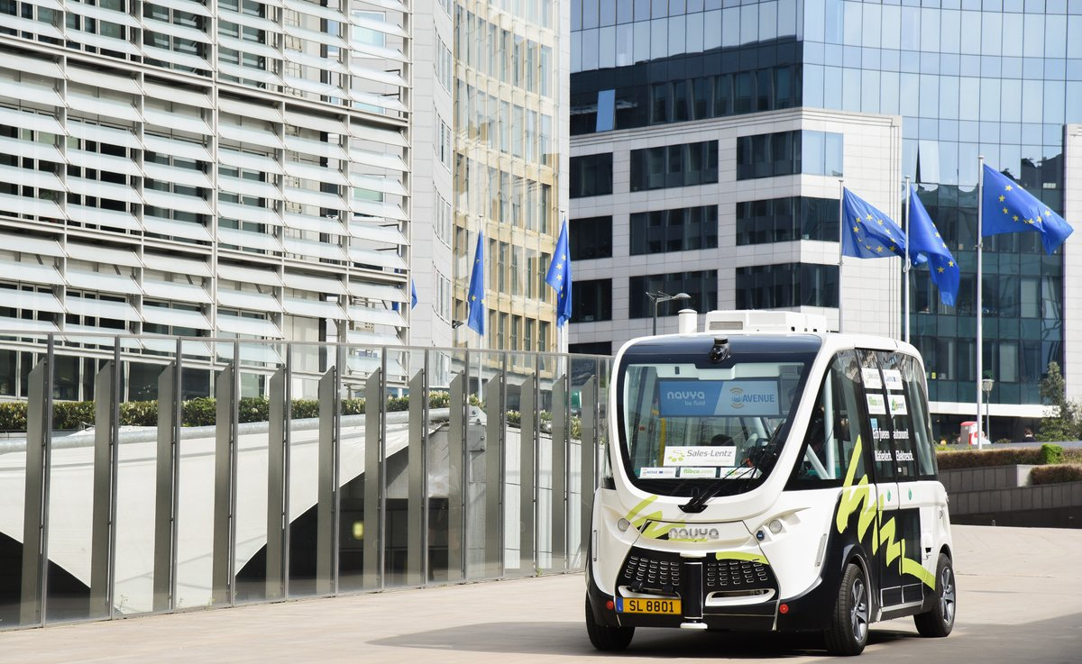
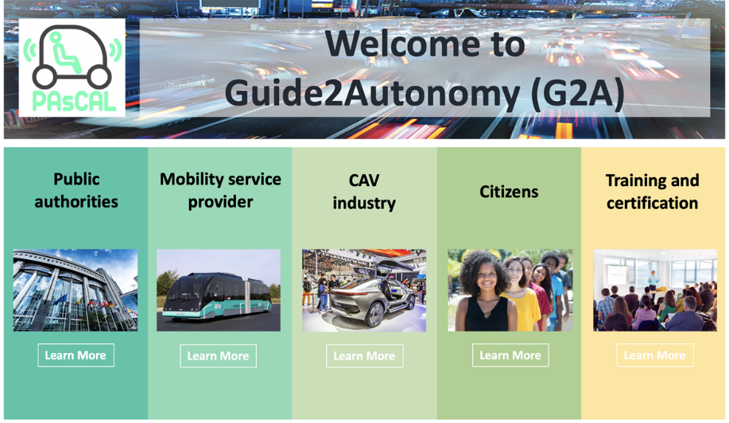
Automated driving
H2020 highlights
The AVENUE Project: testing fleets of autonomous shuttles in low to medium demand areas
grant agreement No. 769033
The PAsCAL Project: Enhance driver behaviour and public acceptance of connected and autonomous vehicles
grant agreement No. 815098

Slide 10
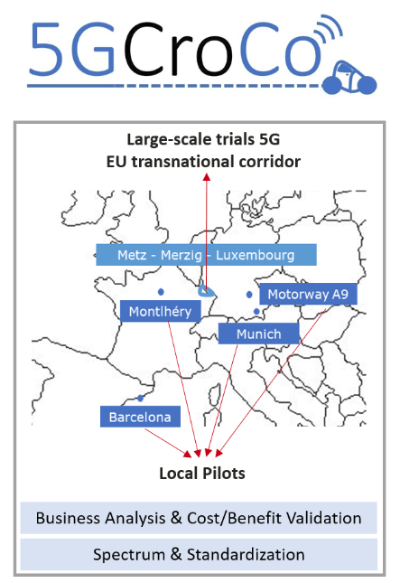
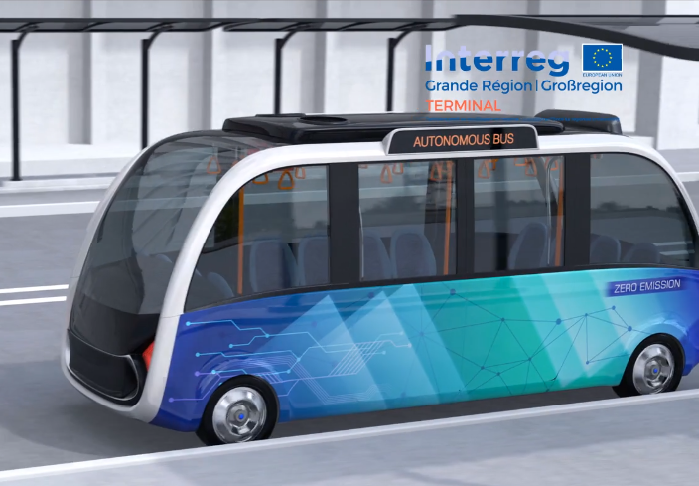
Automated driving
H2020 & INTERREG highlights
The 5GCroCo Project: trial of 5G technologies in the cross-border corridor
grant agreement No. 825050
The TERMINAL Project: evaluation of automated electric shuttle for cross-border commuters
Interreg V Grande Région

Slide 11
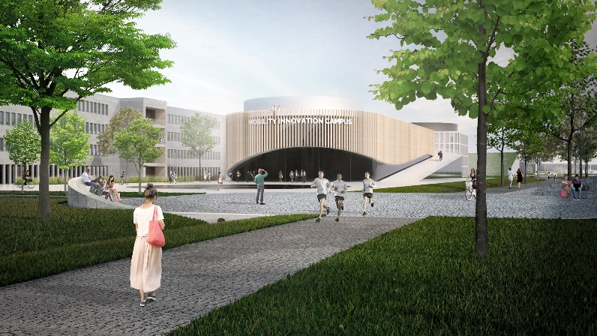
Mobility Innovation Campus
Science park project
  Public-private partnership in open innovation and shared R&D for next generation mobility:
  Total surface: 14 ha
    8 ha still available for new investors
  Hosting capacity: 4,000 engineers & scientists
  Business incubation surface: 1,400 m²
Green
Connected
Automated

Slide 12
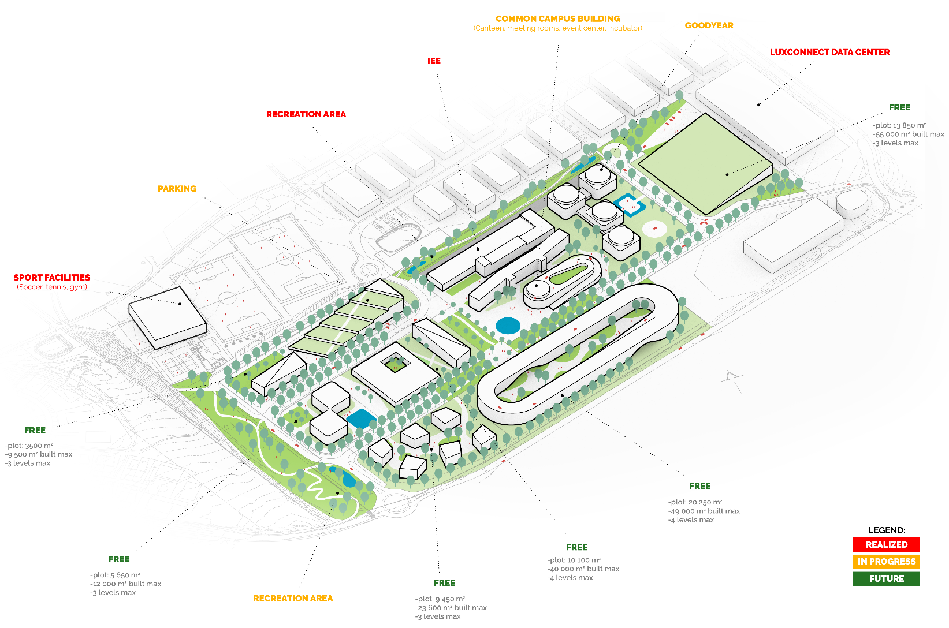
Mobility Innovation Campus
Phase 1 inauguration: Q2-2019

Slide 13
For further information…
  Anthony Auert
    Cluster Manager
    LUXINNOVATION GIE
    5, avenue des Hauts-Fourneaux
    L-4362 Esch-sur-Alzette
    T (+352) 43 62 63 - 870
    M (+352) 621 985 163
    anthony.auert@luxinnovation.lu

Slide 14
  Stefano Pozzi Mucelli
    Senior Advisor, European R&D and Innovation Support
    LUXINNOVATION GIE
    5, avenue des Hauts-Fourneaux
    L-4362 Esch-sur-Alzette
    T (+352) 43 62 63 - 679
    M (+352) 621 777 983
    stefano.pozzimucelli@luxinnovation.lu

