Slide 1
Update on Horizon Europe
ERTRAC Member States and National Technology Platforms Representatives
Brno, 25-26 June 2019
Patrick Mercier-Handisyde
Future Urban and Mobility Systems
DG Research and Innovation

Slide 2
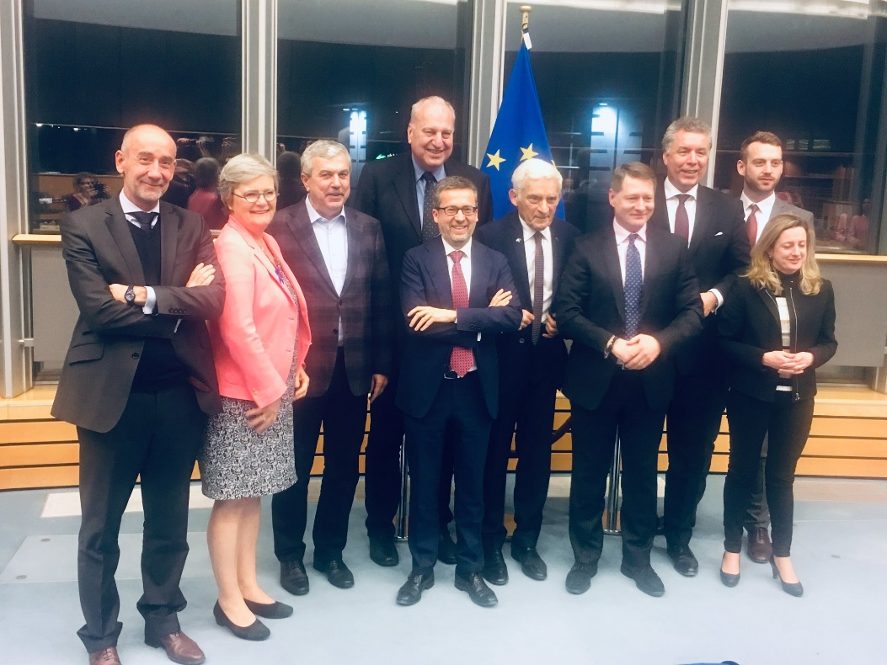
European Parliament and Council reached a common understanding on Horizon Europe on 19 March 2019
Budget, synergies and third country association still pending, depending on the overall MFF negotiations
Commission has started preparations for the implementation of Horizon Europe

Slide 3
Horizon Europe: Preliminary structure
Pillar 1
Excellent Science
Pillar 2
Global Challenges and European Industrial Competitiveness
Pillar 3
Innovative Europe
European Research Council
Health
Culture, Creativity and Inclusive Society
Civil Security for Society
Digital, Industry and Space
Climate, Energy and Mobility
Food, Bioeconomy, Natural Resources, Agriculture and Environment
European Innovation Council
Marie Skłodowska-Curie Actions
Clusters
European innovation
ecosystems
European Institute of Innovation and Technology
Research Infrastructures
Joint Research Centre
Widening Participation and Strengthening the European Research Area
Widening participation and spreading excellence
Reforming and Enhancing the European R&I system

Slide 4
Commission proposal for budget: €100 billion* (2021-2027)
* This envelope includes EUR 3.5 billion allocated under the InvestEU Fund.

Slide 5
Adaptation to climate change, including societal transformation
Healthy oceans, seas, coastal and inland waters
Mission areas
Cancer
Climate-neutral and smart cities
Soil health and food

Slide 6
New approach to European Partnerships
New generation of objective-driven and more ambitious partnerships in support of agreed EU policy objectives
Key features
Simple architecture and toolbox
Coherent life-cycle approach
Strategic orientation
Co-programmed
Based on Memoranda of Understanding / contractual arrangements; implemented independently by the partners and by Horizon Europe
Co-funded
Based on a joint programme agreed and implemented by partners; commitment of partners for financial and in-kind contributions
Institutionalised
Based on long-term dimension and need for high integration; partnerships based on Articles 185 / 187 of TFEU and the EIT-Regulation supported by Horizon Europe

Slide 7
Pillar 2 - Clusters Global Challenges & European Industrial Competitiveness: boosting key technologies and solutions underpinning EU policies & Sustainable Development Goals Commission proposal for budget: € 52.7 billion
Digital, Industry & Space
Civil Security for Society
Health
Food, Bioeconomy, Natural Resources, Agriculture & Environment
Culture, Creativity and Inclusive Societies
Climate, Energy and Mobility

Slide 8
Strategic plan gives direction to the work programme
Horizon Europe legislative package
Strategic Plan 2021-2024
Work programme 2021-2022
Calls for proposals
Main Features
Early involvement and extensive exchanges with Member States
Extensive exchanges with the European Parliament
Consultations with stakeholders and public at large

Slide 9
Steps towards the first Horizon Europe work programme
Summer
2019
Early involvement and exchanges with Member States, consultation with stakeholders and the public at large Establishment of Mission Boards
Autumn-winter 2019/2020
Co-creation at Research & Innovation Days 24 – 26 September. Extensive exchanges with the new European Parliament.
Establishment of new Commission - envisaged endorsement of Strategic Plan
2020
Drafting of first Horizon Europe Work Programme on the basis of the Strategic Plan
2021
Start of Horizon Europe

Slide 10
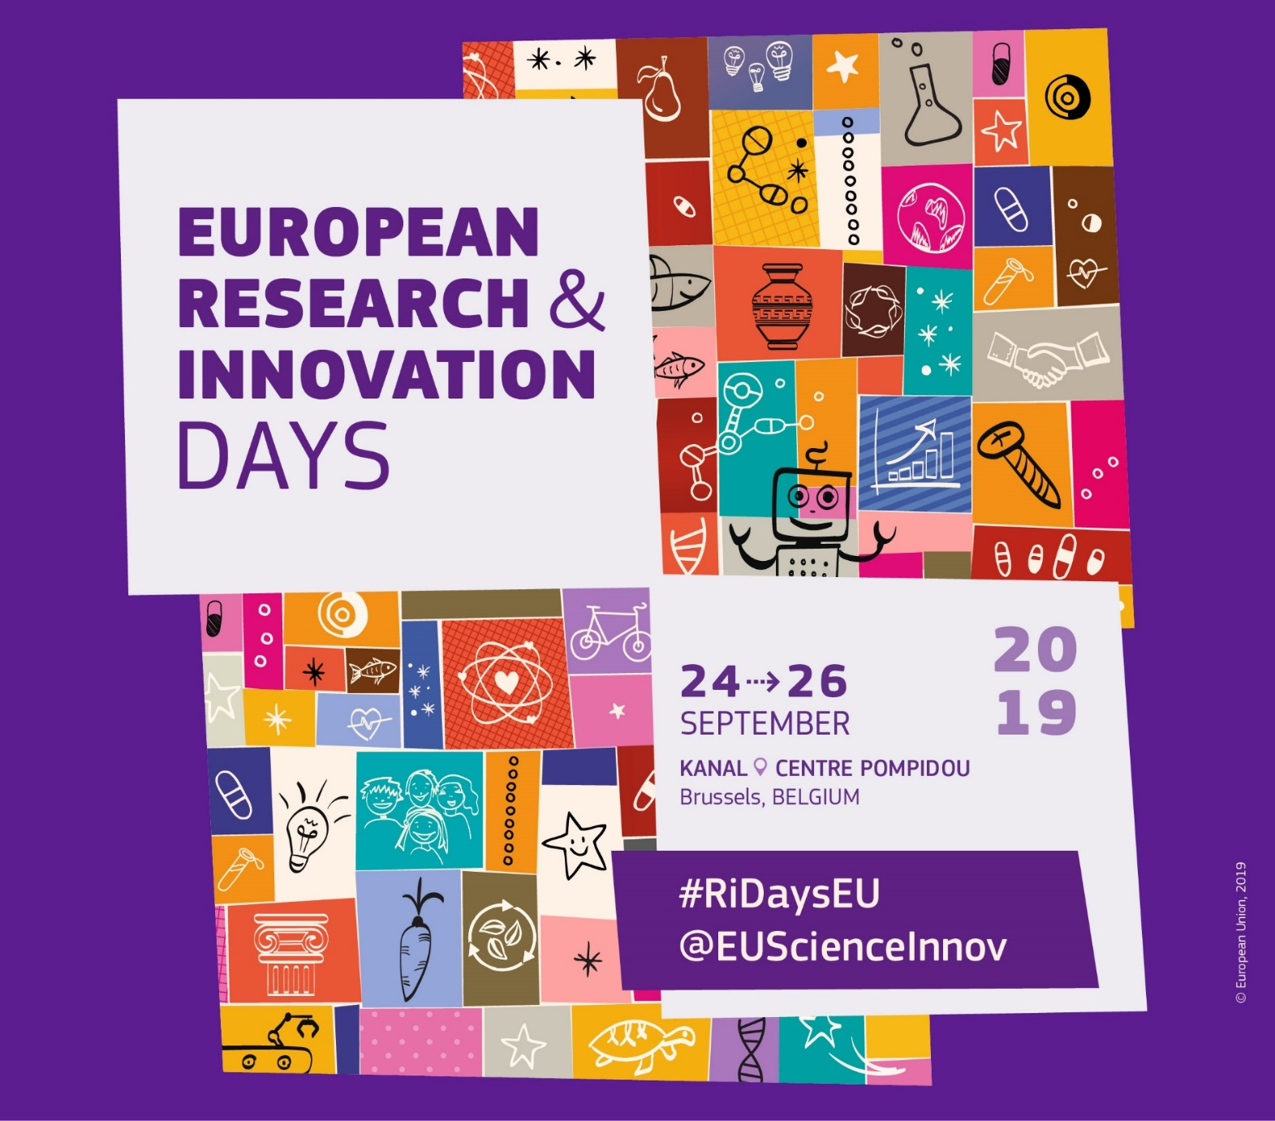
Registration now open: ec.europa.eu/research-innovation-days

Slide 11
Policy Conference
24→ 26 September
Innovative Europe Hub
24→ 26 September
Science is Wonderful! Exhibition
25→ 26 September
20 sessions related to Cluster 5 “Climate, Energy and Mobility” including:
Mission Board “Cities” with Member States (Closed session on 24 September)
A Plenary Session on “Clean Europe – Making carbon-neutrality a reality” (25 September)
Session on “Horizon Europe Mission on Cities” (25 September)
Session on “City as Innovation Lab” (25 September)
Notes:
The Policy Conference brings together high-level policy-makers, leaders from industry, finance, academia and the entrepreneurial community to debate and shape the future research and innovation landscape. It covers vital areas of science, engineering, medicine, and wider social and environmental concerns.
The Innovative Europe Hub is a unique meeting and matchmaking space for innovators, investors, entrepreneurs and the whole range of services, businesses, civil society organisations, agencies and intermediaries that make European science technology so dynamic.
Free and open to everybody, ‘Science is Wonderful!’ Exhibition brings the world of science to the public.

Slide 12
Transport Research Arena (TRA) 2020
Helsinki, Finland, 26-30 April 2020
Rethinking transport: Towards clean and inclusive mobility

Slide 13
Open Calls
Call for submissions: deadline 16th/30th June 2019
Call for demonstrations: deadline 1st October 2019
Call for invited sessions: deadline 1st October 2019
→ Website: https://traconference.eu

