Slide 1
Technology Agency of the Czech Republic
ERTRAC Member States and National Technology Platforms Representatives
Annual meeting Brno 25th June 2019
Milena Vicenová

Slide 2
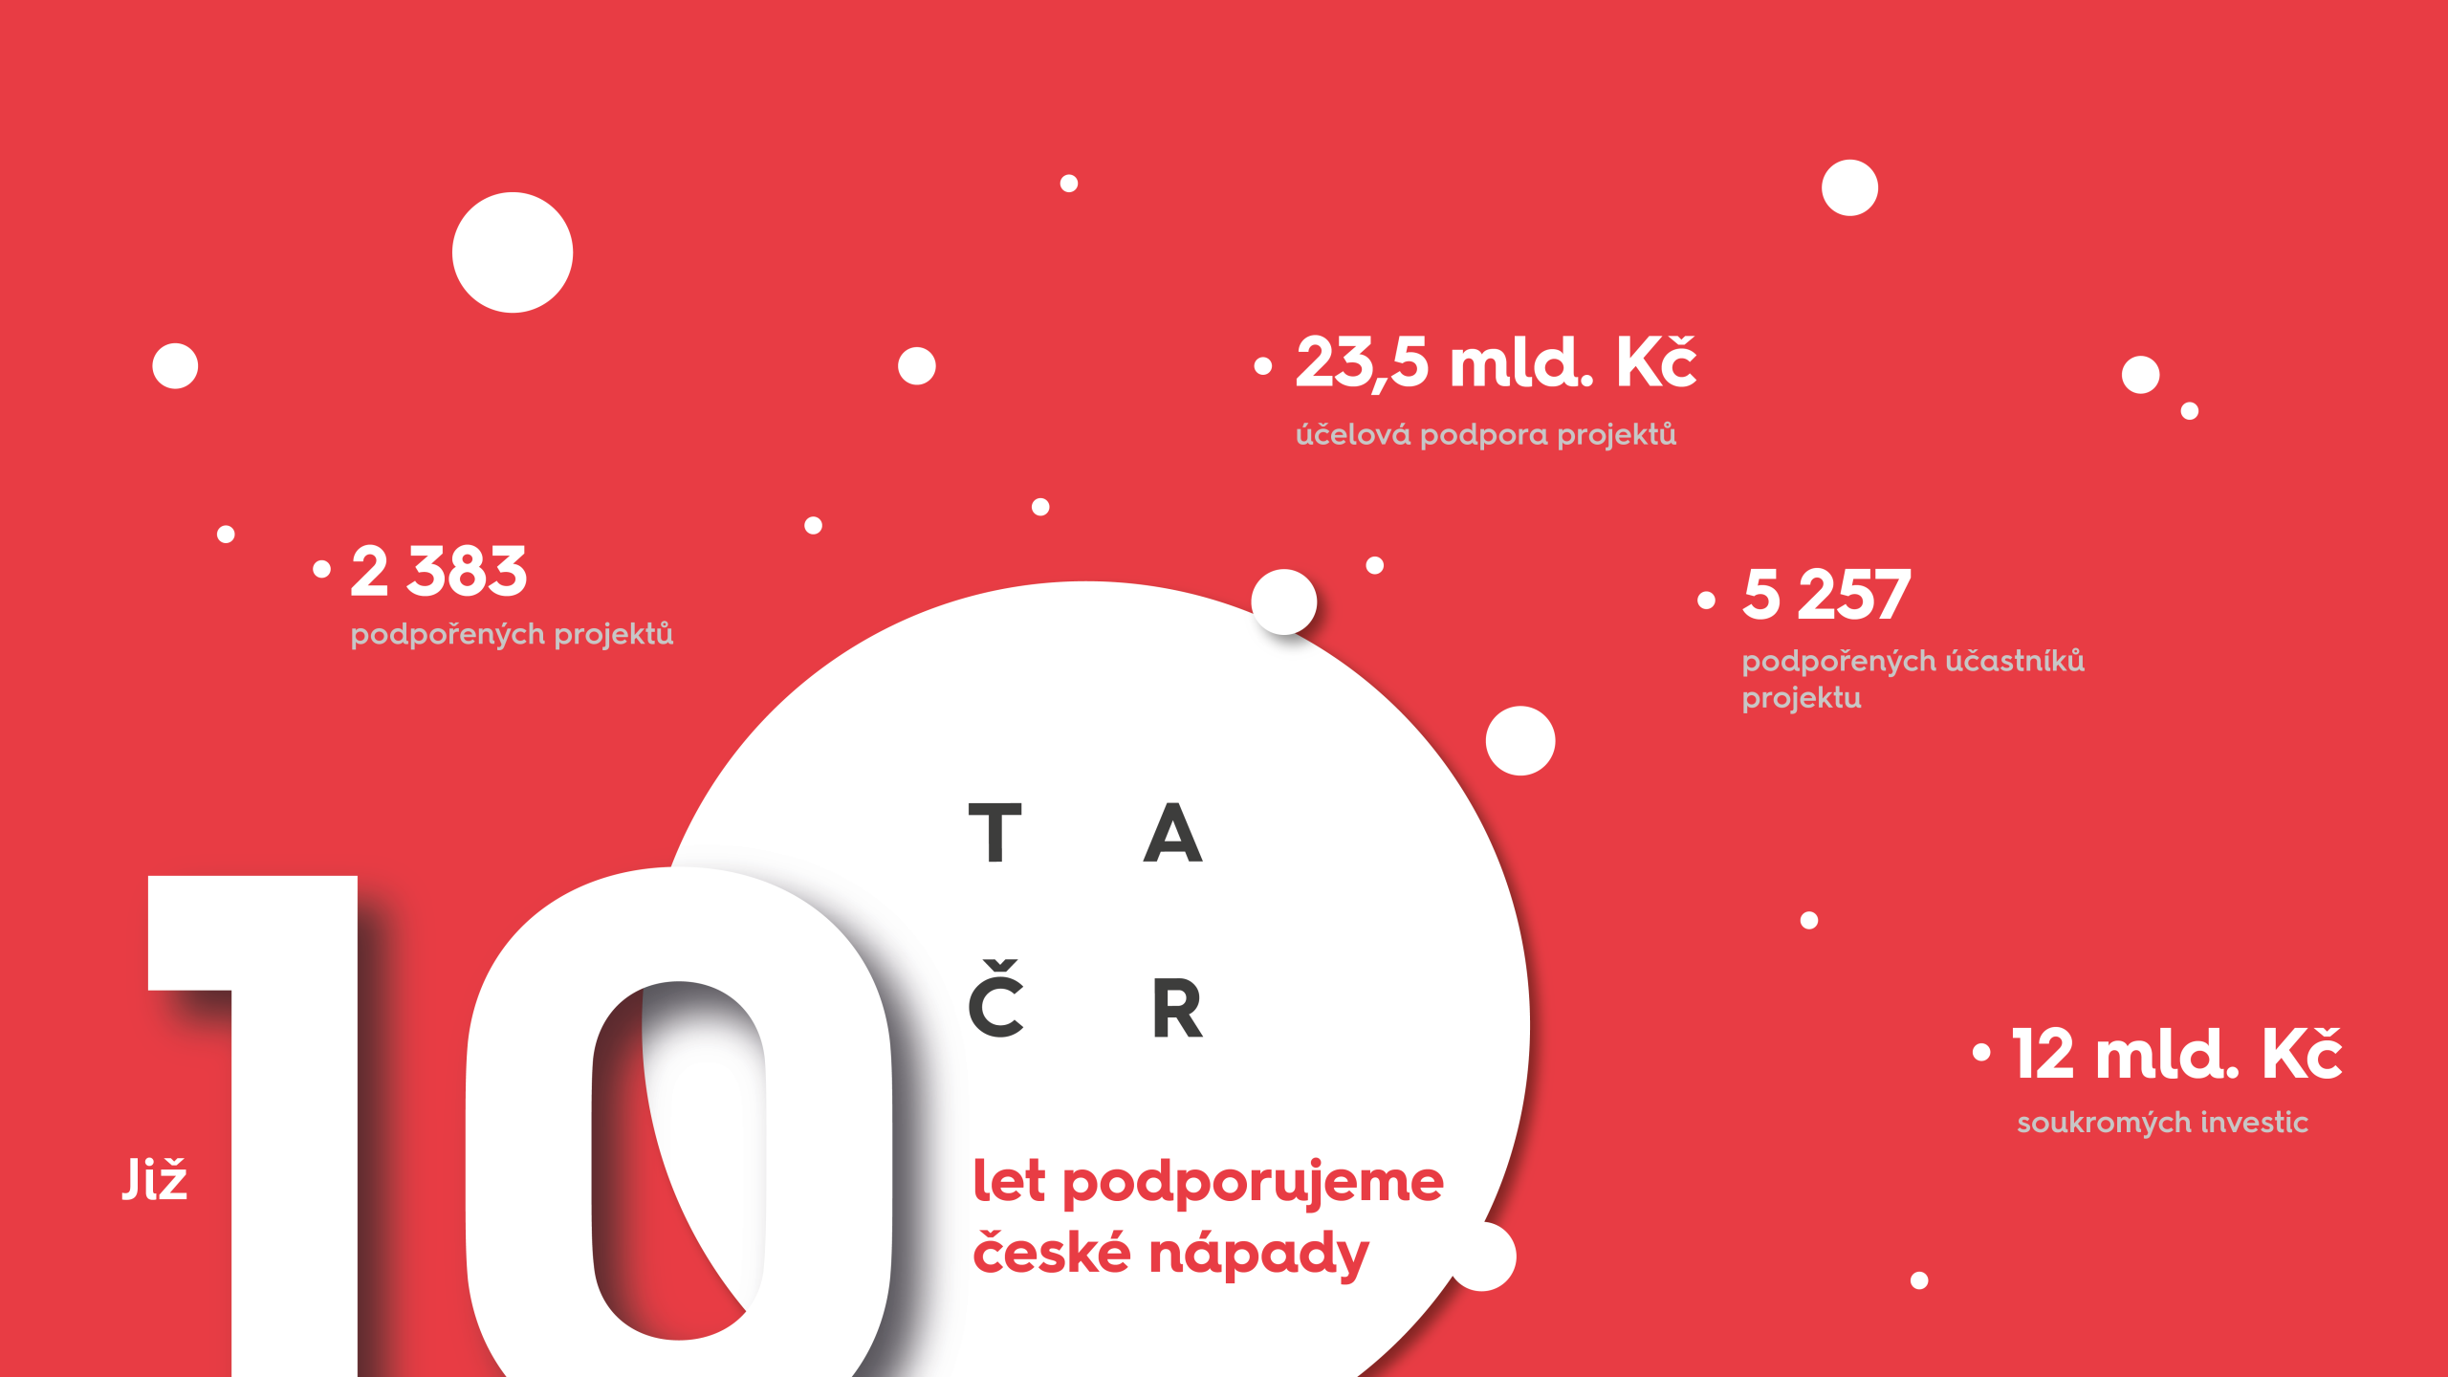
€ 903.9 million
targeted project funding
2 383
projects funded
5 257
project participants supported
€ 461.5 million
private investment
years of supporting Czech ideas

Slide 3

About TA CR
R&D support reform 10 years ago
Concentration of resources
Better cooperation of ministries, between researchers and academic sphere
organisational unit of the state and the administrator of a budget chapter
we prepare and manage state funding programmes whose purpose is to stimulate the interconnection of organisations working on applied research with innovative activities in business and in the state administration
we develop new tools to support closer collaboration between academia, the business sector and the state administration
Notes:
řešení solutions
výzvy challenges
vývoj development
vize vision
inspirace inspiration
inovace innovation
aplikace application
kreativita creativity
umění art

Slide 4
TA CR IN FIGURES
AS OF NOVEMBER 2018
TA CR is expanding every year,
we supported a record number of projects over the past year.
From which
13
854
461,5
66,4 %
10
CALLS FOR PROPOSALS
MIL. €
MIL. €
FUNDING RATE
PROGRAMMES
in 2018
Paid out
until 2018
paid from private contributions

Slide 5
TA CR TARGETS ALL
KEY SECTORS
CULTURAL AND CREATIVE SECTORS
HUMAN AND SOCIETY
INDUSTRY 4.0
SMART AND GREEN
TECHNOLOGIES
MATH
AND PHYSICS
EARTH
SCIENCES
BIO-SCIENCES
CHEMISTRY
INDUSTRY
SOCIAL SCIENCES
MEDICAL SCIENCES
AGRICULTURE
ICT

Slide 6
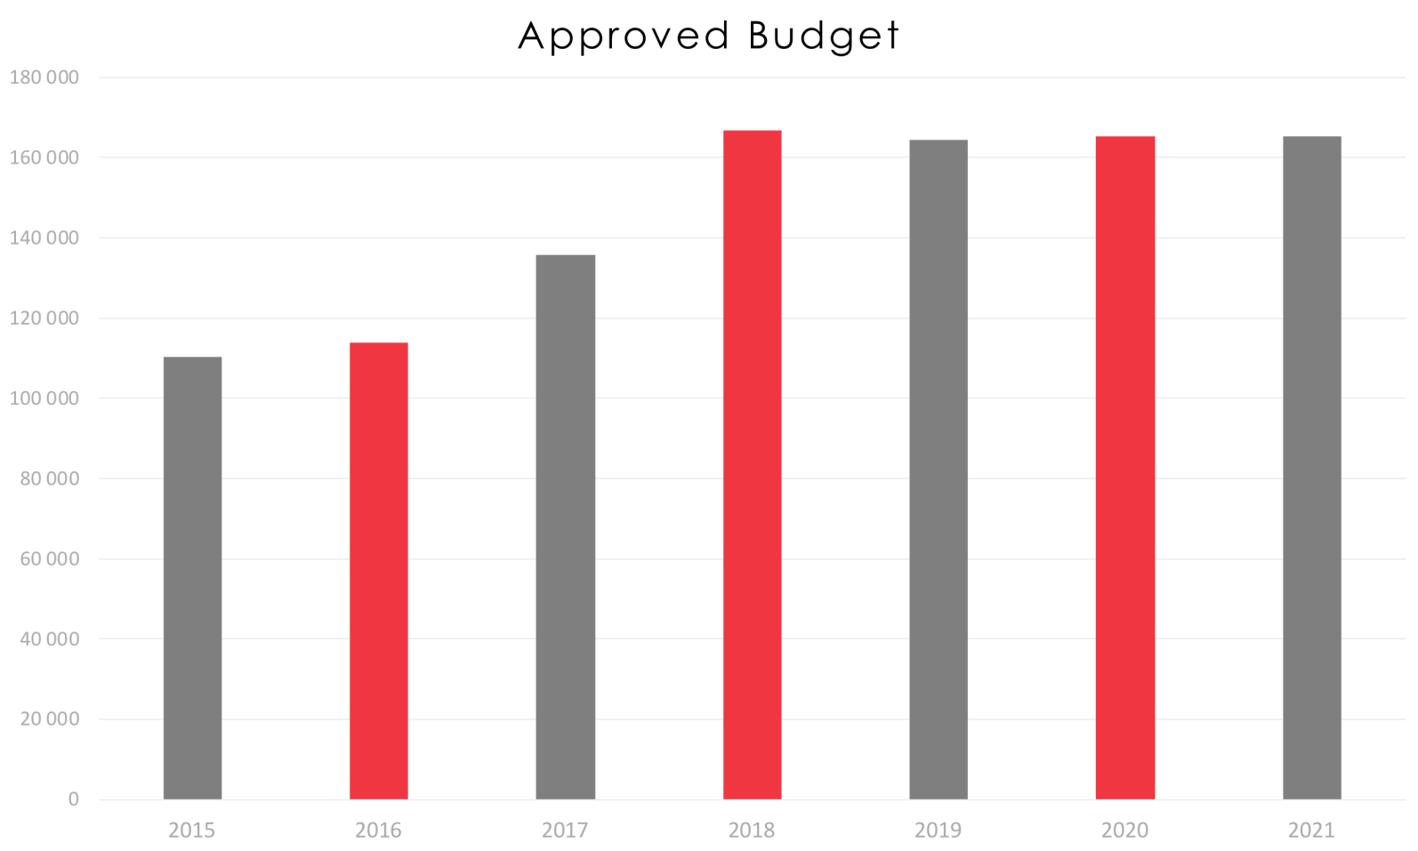
 | 2015 | 2016 | 2017 | 2018 | 2019 | 2020 | 2021
Approved budget (ths. €) | 105 961 | 109 423 | 130 423 | 160 346 | 158 077 | 158 654 | 158 654

Slide 7
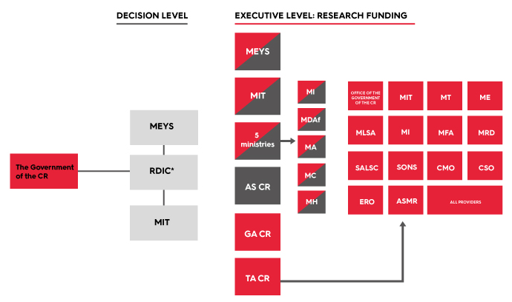
AS CR | Czech Academy of Sciences
ASMR | Administration of State Material Reserves
CMO | Czech Mining Office
CSO | Czech Statistical Office
ERO | Energy Regulatory Office
GA CR | Czech Science Foundation
ME | Ministry of the Environment
MEYS | Ministry of Education, Youth and Sports
MFA | Ministry of Foreign Affairs
MI | Ministry of the Interior
MIT | Ministry of Industry and Trade
MLSA | Ministry of Labour and Social Affairs
MRD | Ministry of Regional Development
MT | Ministry of Transport
RDIC | Research, Development and Innovation Council
SALSC | State Administration of Land Surveying and Cadastre
SONS | State Office for Nuclear Safety
TA CR | Technology Agency of the Czech Republic
* The Research, Development and Innovation Council is chaired by Prime minister of the CR

Slide 8
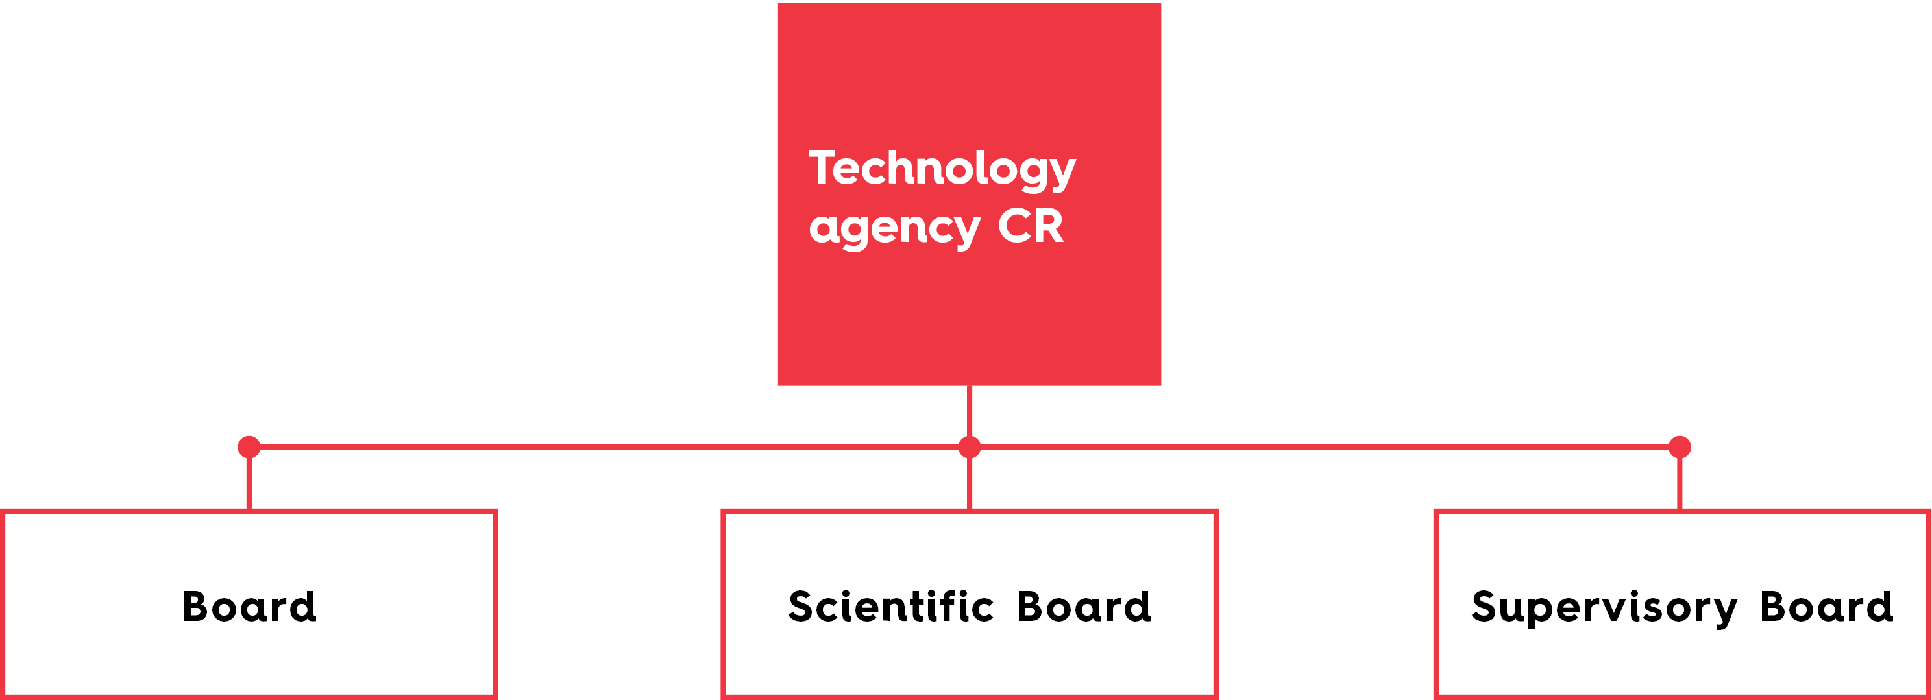

The Research, Development and Innovation Council
is a professional and consultancy body
of the Government of the Czech Republic
in the field of research, experimental development.
It is chaired by the Prime Minister.
The Council proposes the Chair and the Board of TA CR.
the executive body of TA CR
appointed by the Government
headed by the Chairman
at this time represented
by Petr Konvalinka
the policy-making authority
of TA CR
appointed by Government
headed by the Chairman Martin Fusek
supervisory body of TA CR
appointed by the Chamber of Deputies
headed by the Chair
Anna Putnová

Slide 9



BETA2
GAMMA 2
KAPPA
TREND
  programme of RD&I public procurement for state administration
  verification of the results of R&D for practical application and commercial use
strengthening the development of knowledge based on research by means of international cooperation in the area of applied research. Supporting carbon capture and storage projects
  increase the international competitiveness of enterprises
NATIONAL COMPETENCE
CENTRES
ETA
EPSILON
Prostředí
pro život
  support of projects whose results have a high potential for rapid application on the market
  effective cooperation between research organisations and R&D results users, establishment and operation of RD&I centres in progressive fields to increase the competitiveness of the Czech Republic
  involvement of the social sciences and humanities in projects of technical and non-technical RD&I
introduction of new environmental solutions
THETA
ZETA
DELTA 2
DOPRAVA
2020+
  R&D support in energy focusing on state supervision of nuclear safety
  and the long-term technical perspectives of the energy sector
  involvement of the young generation of researchers in applied research projects
  bilateral collaboration in applied research with international partners
  development
  of the transport sector

Slide 10
Information about projects for transportation realised by TA CR in the past period
PROJECTS TRANSPORTATION total
MoT
TA CR
Programmes
  ALFA
  BETA + BETA 2
  GAMA
  OMEGA
  ZÉTA
  ÉTA
PROJECTS FUNDING
  698
  150
  152
  81
  29 + 2
  1
  6
  5
  4
  4 500 € - 2,164 mil. €

Slide 11
TENTATIVE TIMELINE
CALLS FOR PROPOSALS 2019
CALL FOR PROPOSALS | CFP ANNOUNCEMENT DATE
TREND programme, first CFP | 15 May 2019
DOPRAVA 2020+ programme, first CFP | 12 June 2019
Prostředí pro život programme, first CFP | 12 June 2019
DELTA 2 programme, first CFP | 25 June 2019
ETA programme, third CFP | second half of 2019
ZETA programme, fourth CFP
THETA programme, third CFP
KAPPA programme, first CFP
BiodivClim Call 2019
CHIST-ERA Call 2019
ERA-MIN Call 2019
EuroNanoMed Call 2020
This schedule is tentative and may change.

Slide 12
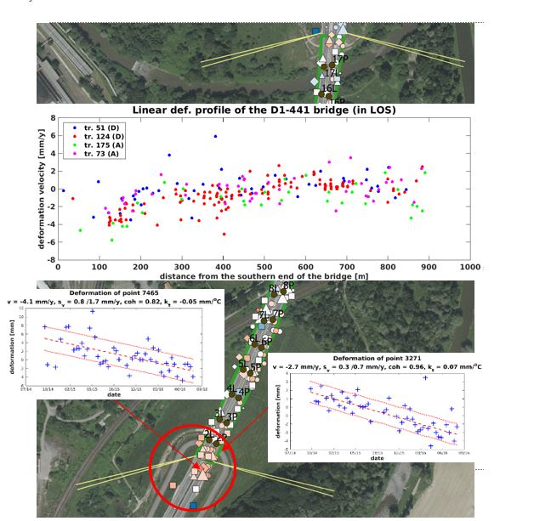
Project awarded TA CR Price 2018
GISAT s.r.o. winner
in categoryGOVERNANCE
Feasibility assessment methodology for monitoring of transportation infrastructure deformations by means
of satellite interferometry

Slide 13


First call for proposals
DOPRAVA 2020+ programme
OBJECTIVE
development of the transport sector
FOCUS
sustainable transport
safe and resilient transport and transport infrastructure
accessible and interoperable transport
automation, digitalisation, navigation and satellite systems

Slide 14
Information about the first call for proposals in The DOPRAVA 2020+ programme
FIRST CALL FOR PROPOSALS
EVALUATION PERIOD
ALLOCATION FOR THE FIRST CFP
MAX. PROJECT FUNDING
MAX. PROJECT FUNDING INTENSITY
PROJECT DURATION
APPLICANTS
  13 June 2019 – 13 August 2019
  14 August 2019 – 31 January 2020
  € 19.26 million
  € 1.92 million
  80%
  12 – 48 months
  RO and enterprises

Slide 15
EU Programmes
TAFTIE
  CHIST-ERA III
  M-ERA.NET 2
  GENDER NET Plus
  EuroNanoMed3
  GEECCO
  NewHoRRIzon
  TAFTIE Chair 2017
DELTA Programme
HORIZON Europe
Kappa Programme

Slide 16

INKA Project
Setting up a methodology for mapping the innovation potential of the CR, that is sustainable and will enable comparison of data over time;
A unique combination of data (both macroeconomic ande microeconomic) and of primary data from structured interviews (in companies nad research organisations);
Ministry of Industry and Trade, Ministry of Education, Youth and Sports and Ministry of Labour and Social Affairs = project partners;
other ministries and the Office of the Government of CR are kept informed.
Information available:
https://inkaviz.tacr.cz/en

Slide 17
www.tacr.cz

