Slide 1





Elektromobilita
Asociace elektromobilového průmyslu
Ing. Jaromír Marušinec, Ph.D. MBA
Konference Technologické trendy v silniční dopravě, Olomouc, 27.11.2018

Slide 3
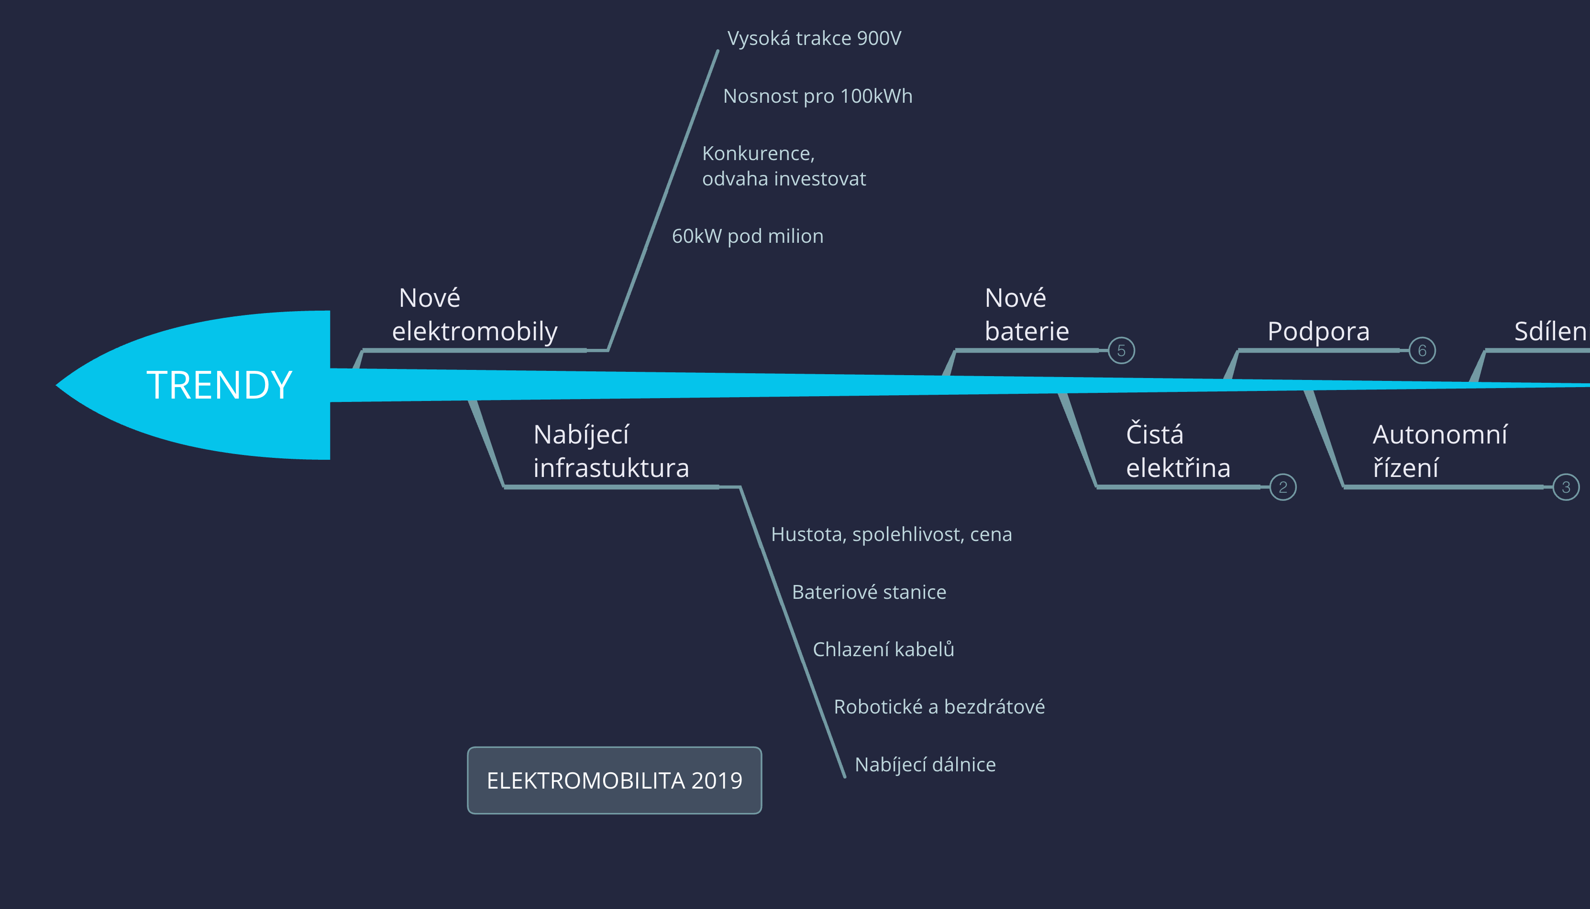

Slide 4
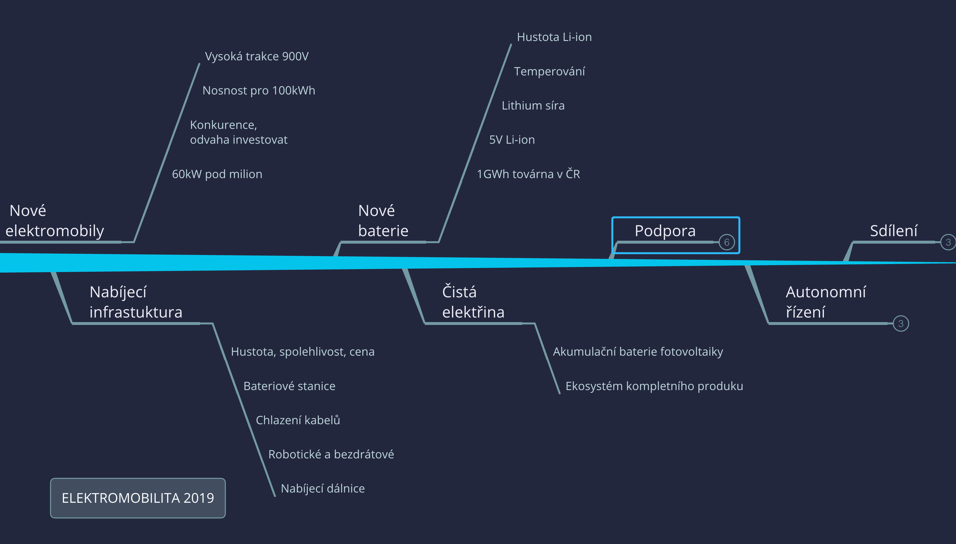

Slide 5
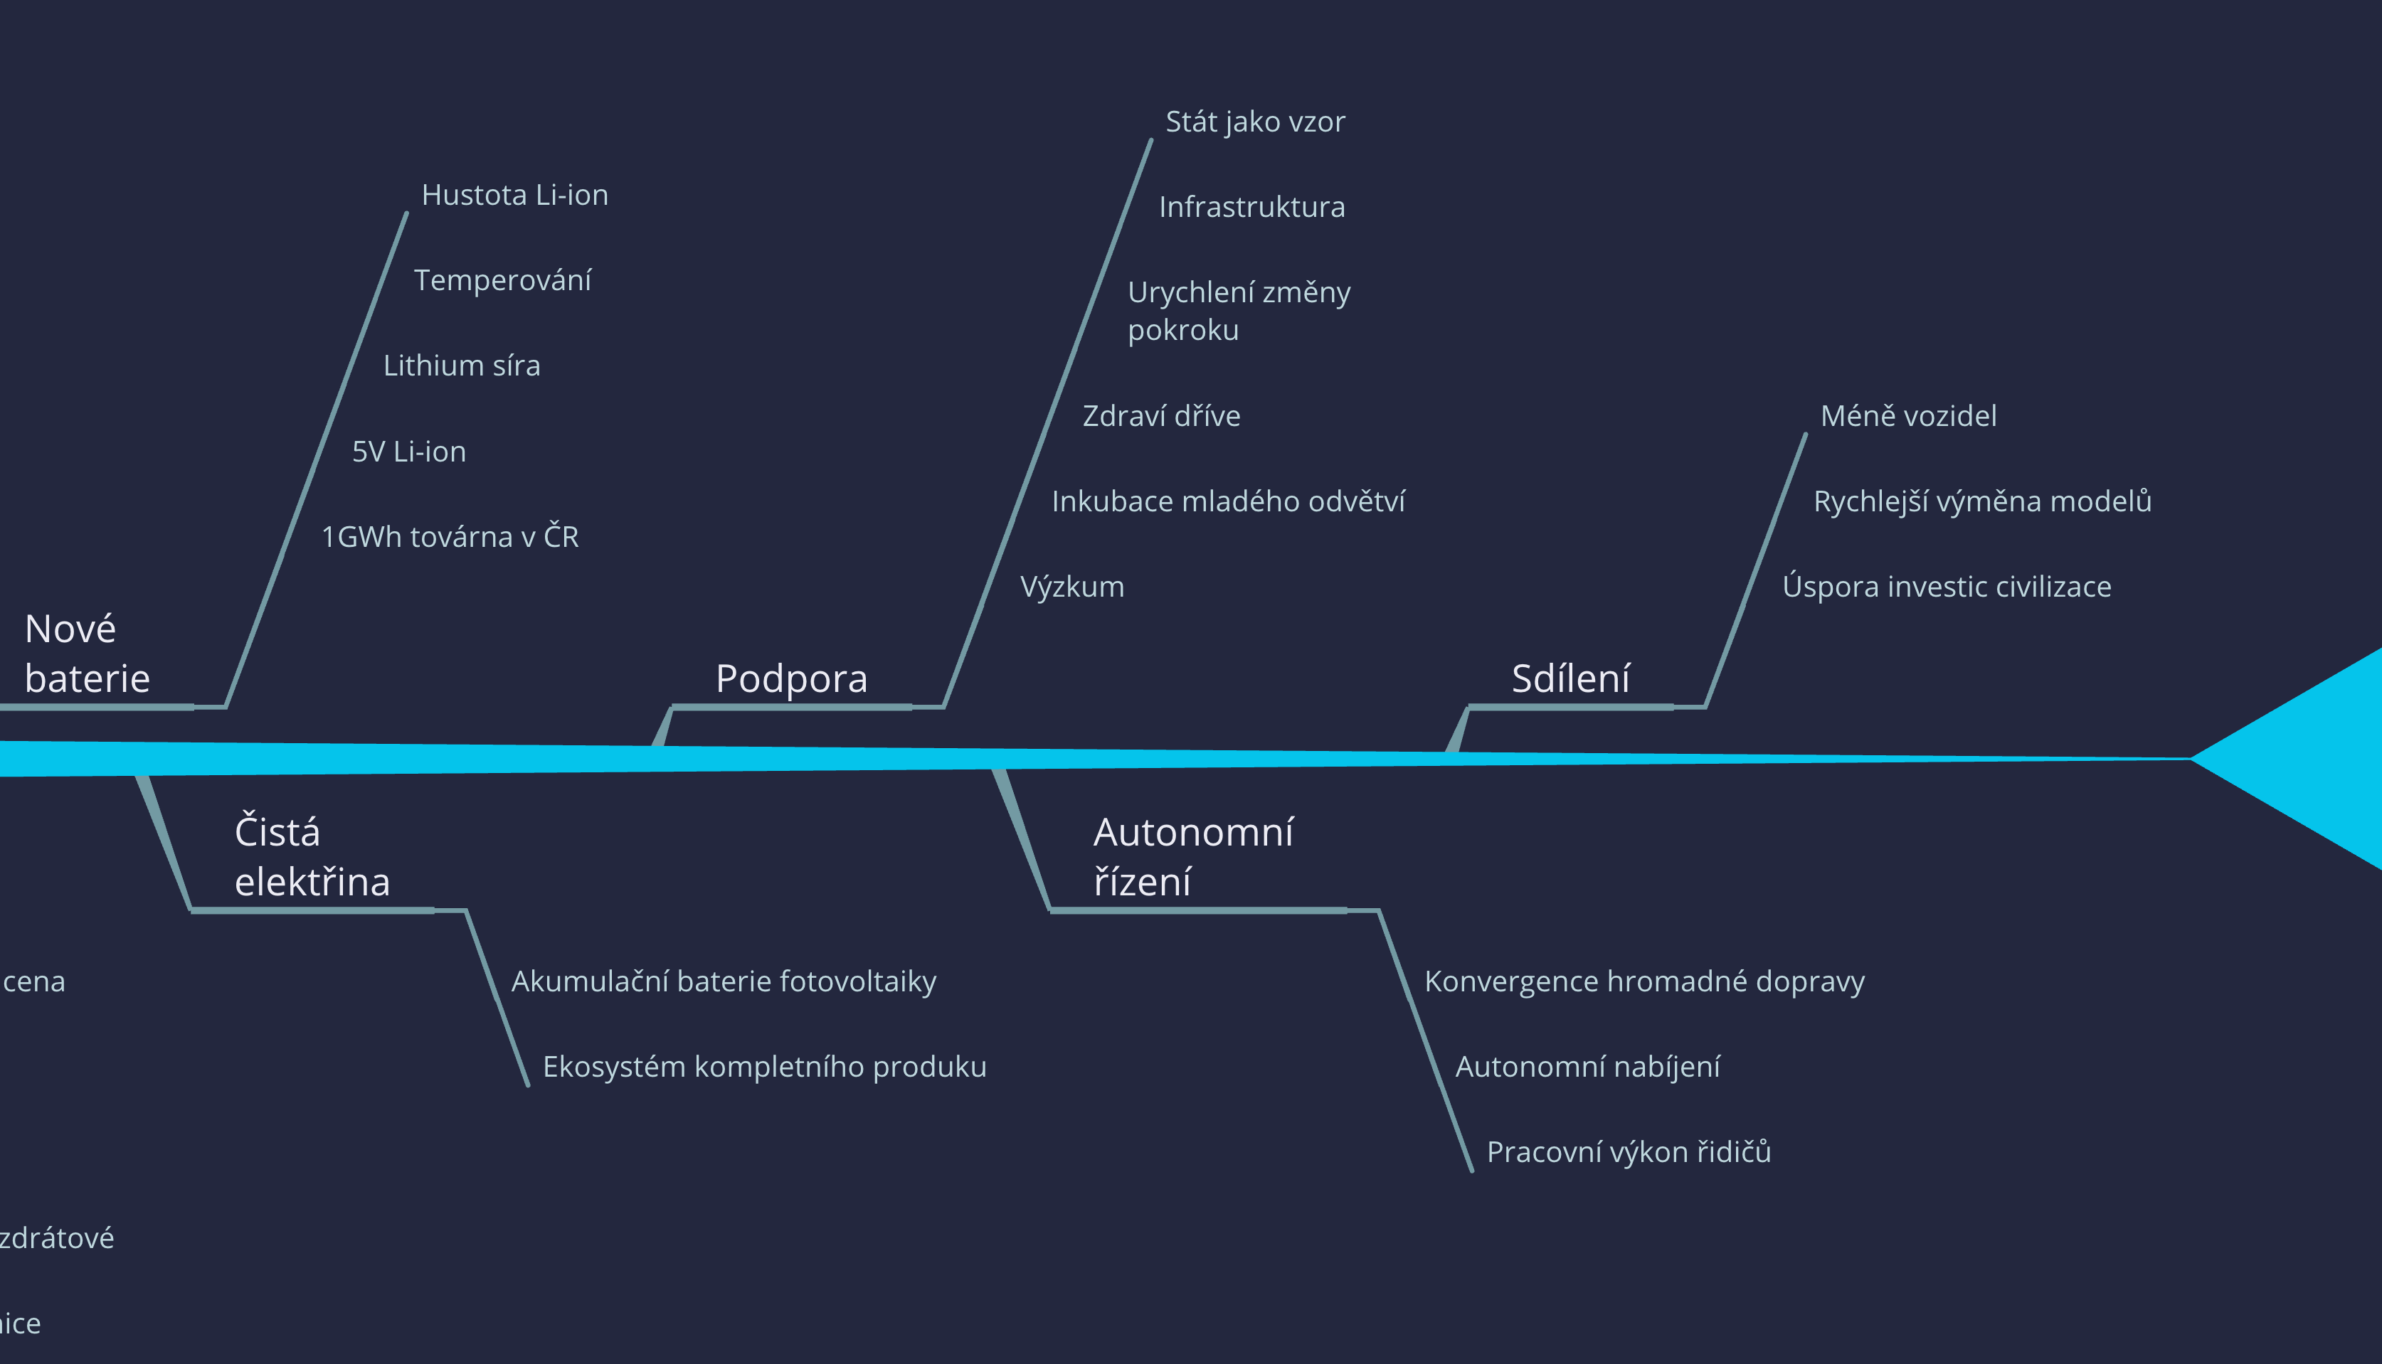

Slide 6
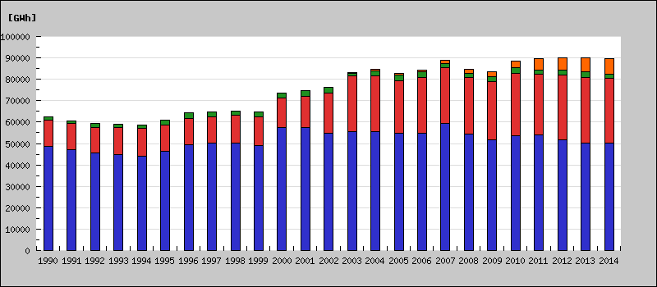
We will need a new power sources?
In Czech Republic we consume 90TWh / year

Slide 7
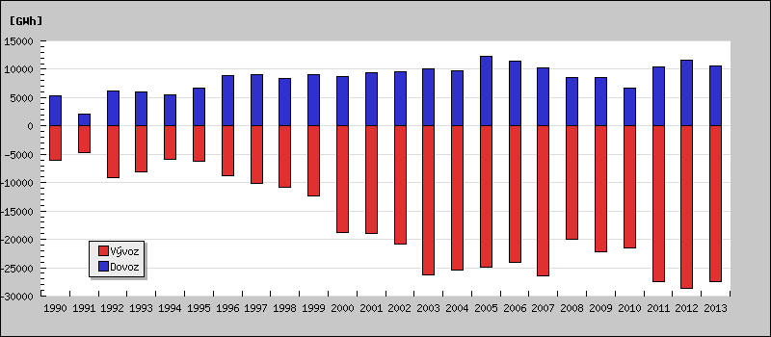
We will need a new power sources?
We will export 17 TWh a year to our neighbors
Notes:
Zdroj http://issar.cenia.cz/issar/page.php?id=1560

Slide 8

How much energy we need for 1 million electric vehicles
Average car 20 000 km/Year
Average consumption 20 kWh/100km
1 EV:
20 000 km . $\frac{20 kWh}{100 km}$
$$=200.20kWh=4 000 kWh=4 MWh$$
1 000 000 EV need 4 TWh
< 5% of production
In the Czech Republic we will produce 90 TWh per year and the power plants are loaded to 50% of which 17 TWh per year is exported
Notes:
+3 min: 13min
Průměrné auto ujede 20 000 km ročně.
Průměrná spotřeba elektromobilů včetně nákladních je 20 kWh/100km
Kolik elektřiny v česku spotřebuje milion elektromobilů?
1 000 000 elektromobilů ročně spotřebuje 4 TWh
Přitom V ČR vyrobí 87 TWh ročně a elektrárny jsou vytížené na 50%
z toho se vyveze 17 TWh
To znamená že bychom za 30 let nespotřebovali pro millon elektromobilů ani 5% dnešní výroby. Ale v té době již bude výroba daleko vyšší.
* zdroj: http://cs.wikipedia.org/wiki/Koeficient_ro%C4%8Dn%C3%ADho_vyu%C5%BEit%C3%AD

Slide 9
Indirect emissions EV - gCO2/km
The direct and indirect emissions of the internal combustion engine increase with the age of the vehicle and engine.
Indirect emissions of electric cars are declining over time as electricity is produced more cleanly.
Vehicle emissions purchased this year
Lower noise and dust from brake linings, clutches, fuel and oil leaks
Notes:
Někdy můžete zaslechnout, že elektromobily mají vysoké nepřímé emise z výroby elektřiny. Porovnejme si jaké jsou emise elektromobilu a spalovacího vozu, který byste si koupili letos. Nepřímé emise z výroby elektřiny jsou v ČR kolem 85g CO2/km. To je opravdu srovnatelné přímými emisemi moderních aut, které mají kolem 100g CO2/km. Ale jak spalovací motor a výfuk stárne, přímé emise rostou.
U spalovacích vozů je třeba zahnout také opomíjené nepřímé emise z výroby a dopravy paliv. Pak objem emisí za dobu životnosti je neporovnatelný.

Slide 10
NEW ELECTRIC CARS REGISTRATIONS IN CZECH REPUBLIC

Slide 11
ČESKÁ REPUBLIKA
VW TESLA
NISSAN BMW

Slide 12
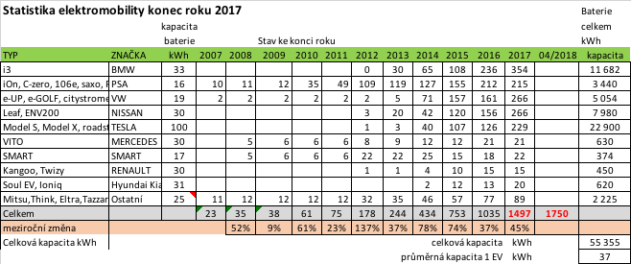
EV statistics in Czech Republic

Slide 13
EV statistics in Czech Republic
Konec roku

Slide 14

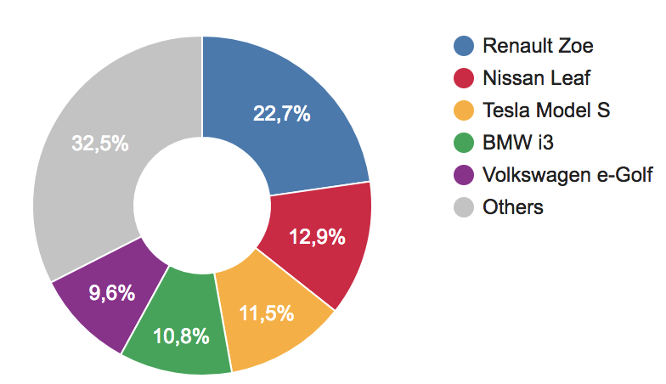
EV sales in EU 2017

Slide 15
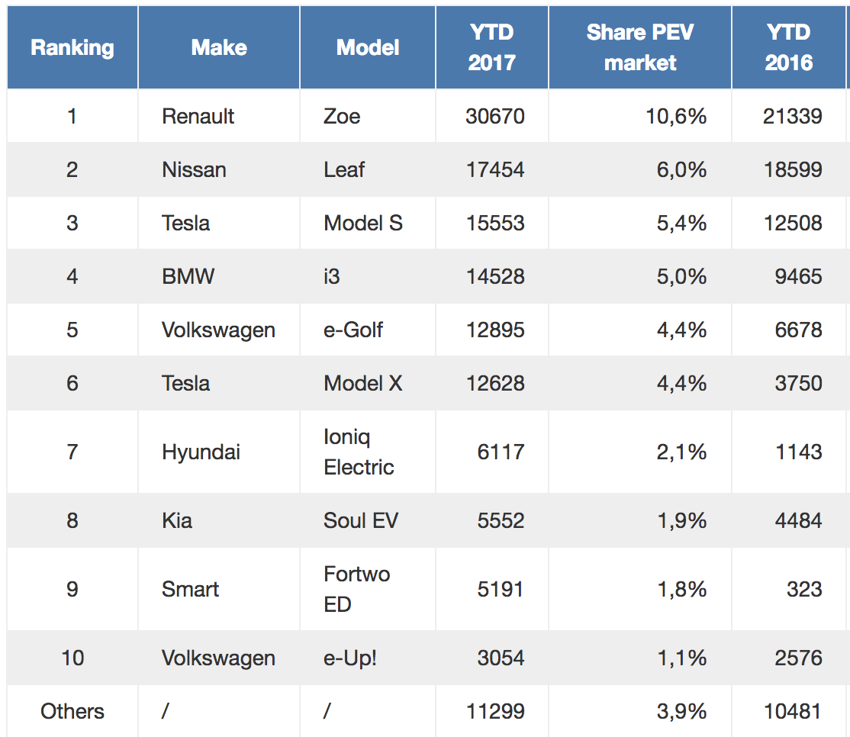
(91 346 v 2016)
134 941 EV sales 2017 +48%

Slide 16
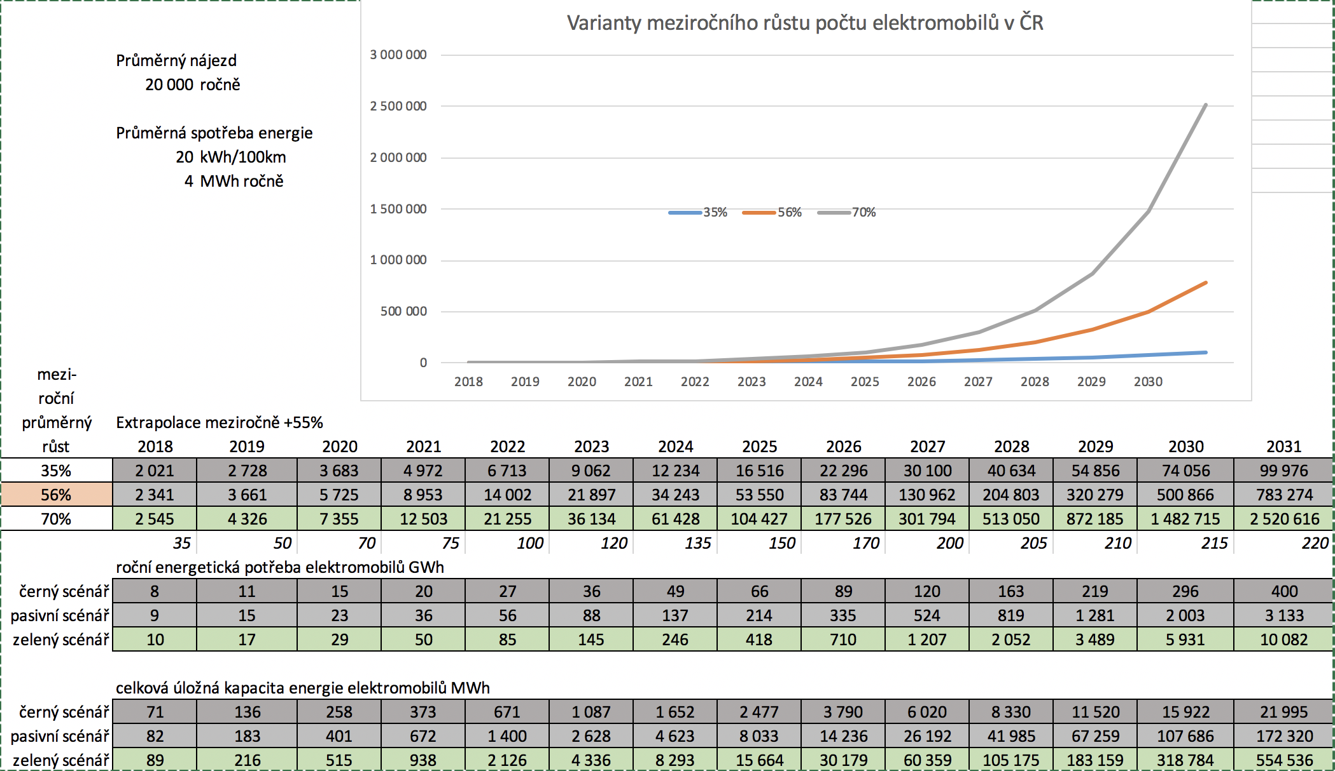
ELECTRIC CAR as accumulator for energy smart grid
Using of 30% of EV capacity

Slide 17
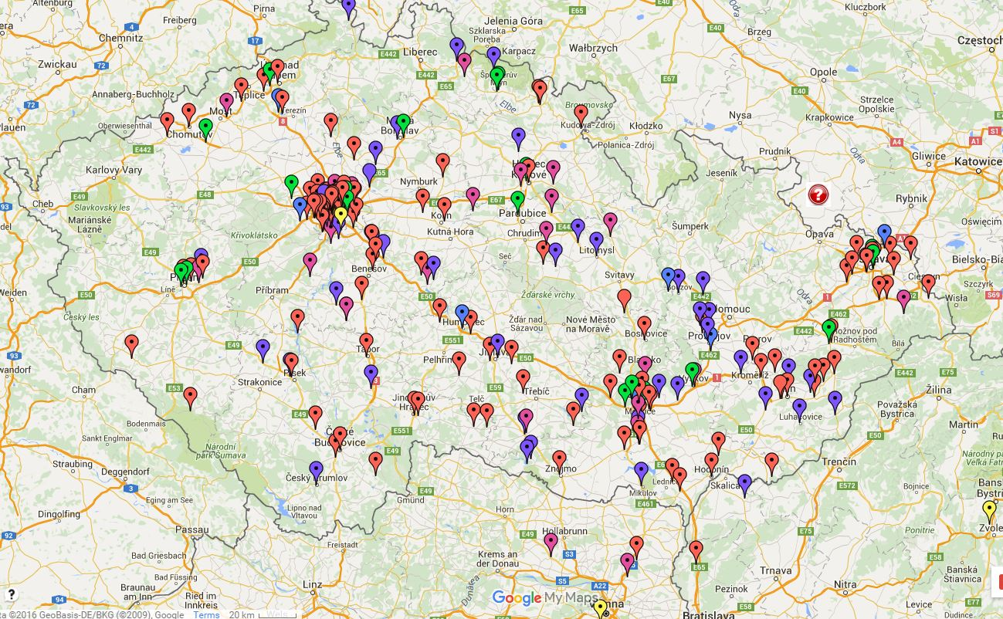
Czech EV charging infrastructure

Slide 18
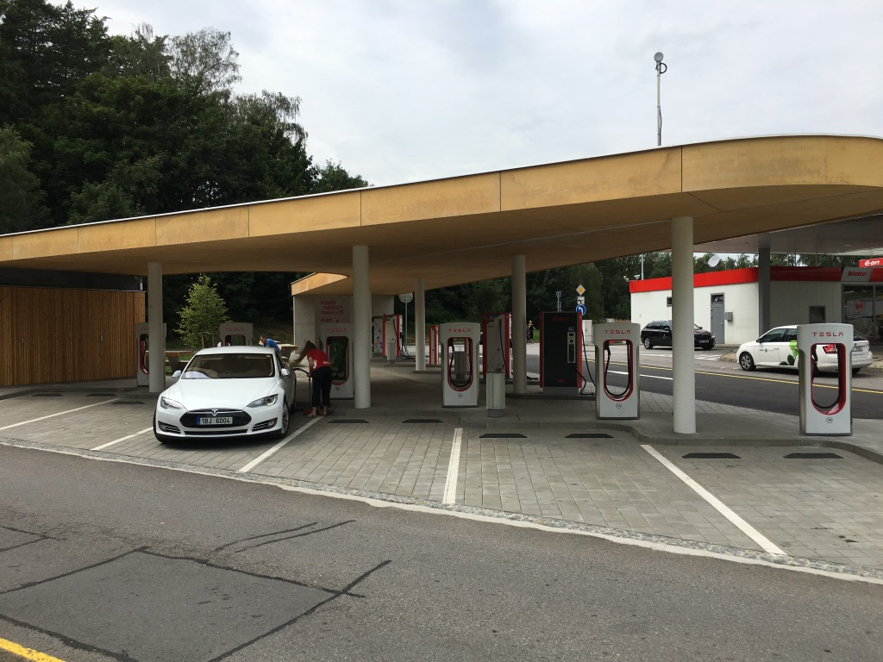
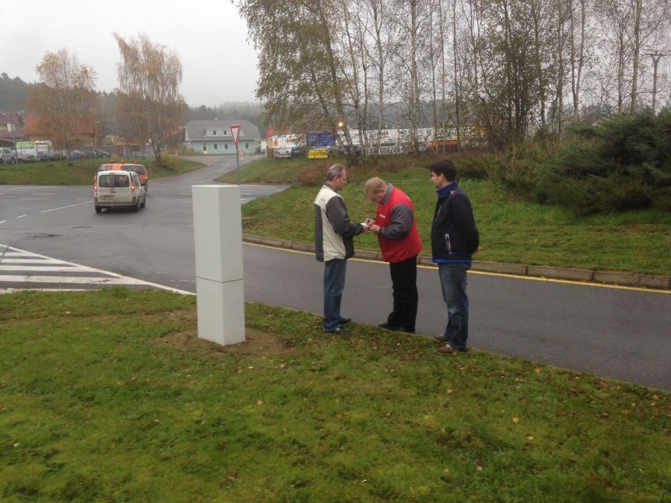
First Tesla
Supercharger
Humpolec
https://www.youtube.com/watch?v=j8UaE4-kmhg

Slide 19
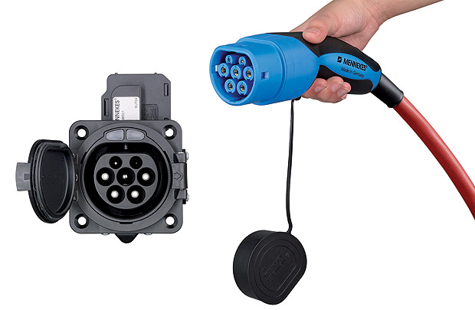
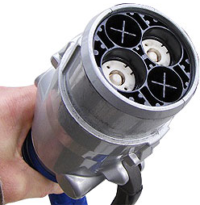

Renewable sources will be accumulating in electric vehicles
Storing solar energy in vehicles - bidirectional energy flow
Limited pumping from vehicles at energy peak

Slide 20
Charching stations in Czech Republic

Slide 21
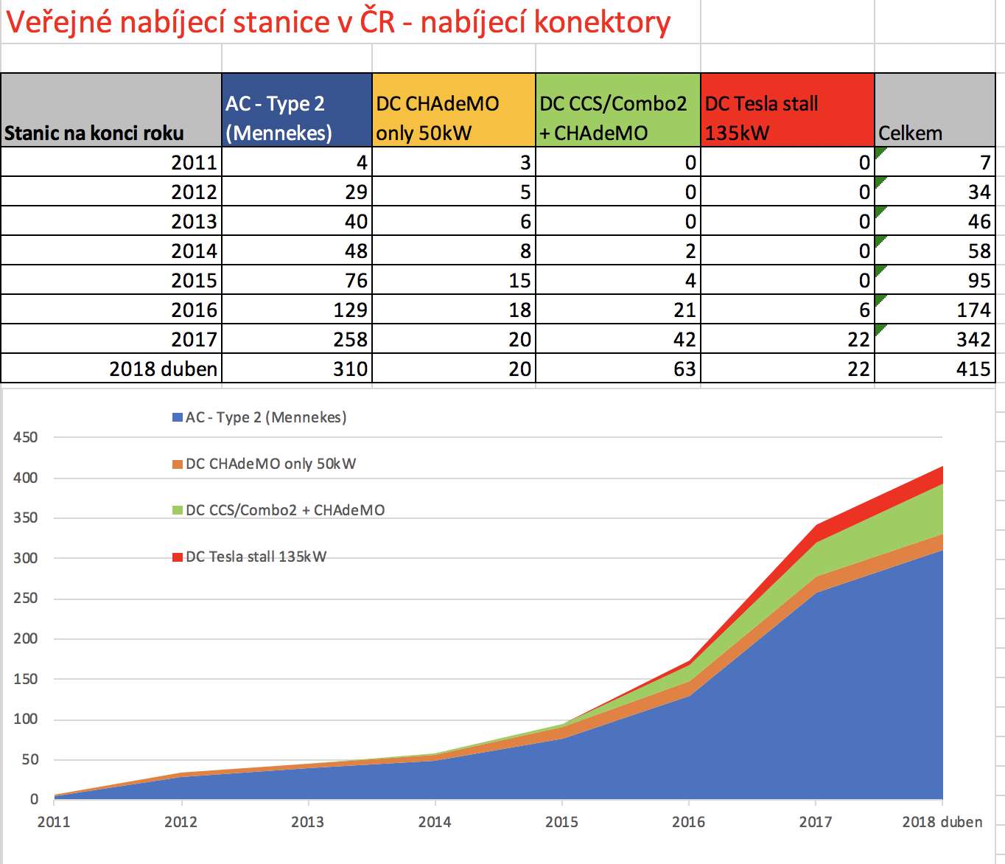
Charching stations in Czech Republic

Slide 22
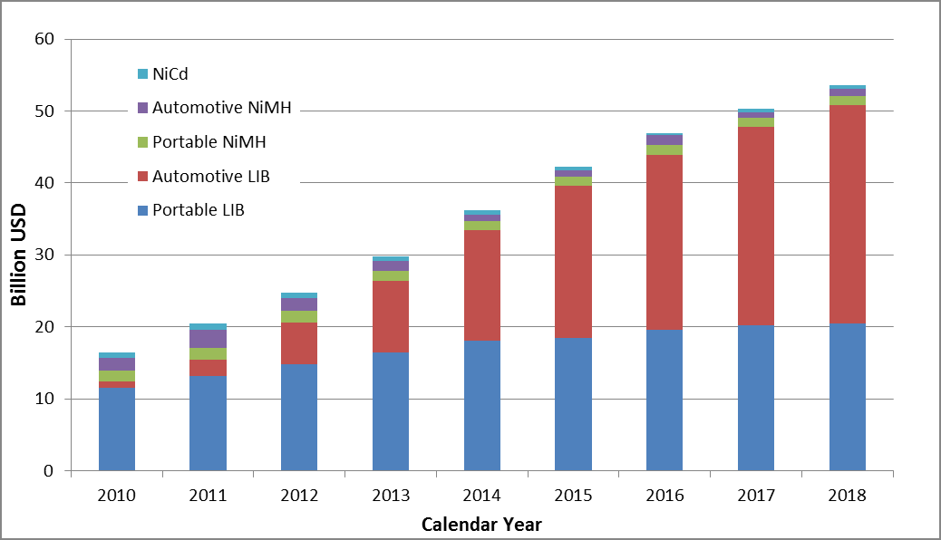
Battery utilization in electric cars
EV
ELECTRONICS

Slide 24
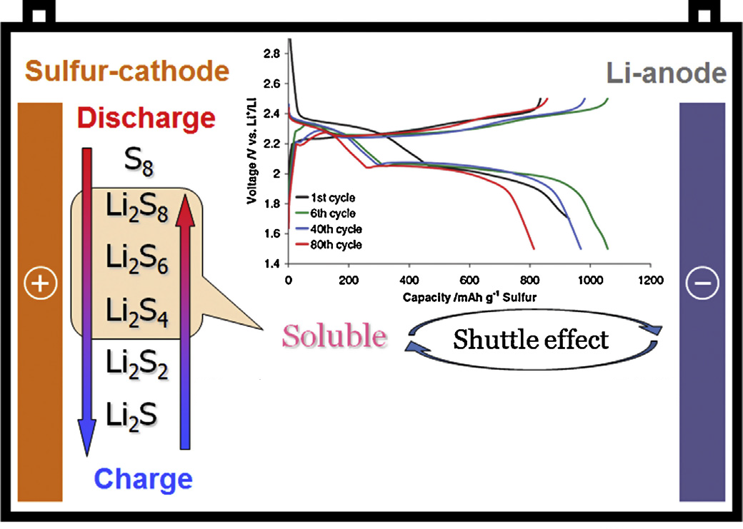
The future of energy storage = lithium-sulfur batteries
LOWCOST SULFUR
S ~ 3 EUR/kg vs.
LiFePO₄ ~ 52 EUR/kg

Slide 25
Comparing Li-S a Li-Ion batteries
Kapacity
kWh
FOR
500kg
EV RANGE
WITH
500kg
BATTERY
400 2 000 km
Tesla S – battery pack 85 000 Wh, weight - 544 kg
NCA 700 Wh/kg
121.4 kg – 22.3 % of battery weight
S – 3200 Wh/kg
26.6 kg ~ 21.9 % of the original weight
Possible decrease of the entire battery pack weight to 119 kg or the same weight of battery pack (544 kg) but with energy ~ 388 000 Wh
Range extension from 440 km to 2010 km
Tesla S – battery pack 85 000 Wh, weight - 544 kg
NCA 700 Wh/kg
121.4 kg – 22.3 % of battery weight
S – 2000 Wh/kg
42.5 kg ~ 35 % of the original weight
Possible decrease of the entire battery pack weight to 190.4 kg or the same weight of battery pack (544 kg) but with energy ~ 243 000 Wh
Range extension from 440 km to 1250 km
300 1 500 km
200 1 000 km
100 500 km
50 250 km
Fig.5: Comparison of capacity and gravimetric energy density. [3]
^{Lithium–sulphur batteries}

Slide 26
Lithium Sulfur LiS
The first 180 cycles of capacity increase, after 400 cycles is again new
Every 1 200 km cycle - will be like new after 500 000 km
NCA Tesla
NMC VW, BMW
LiFePO4

Slide 27
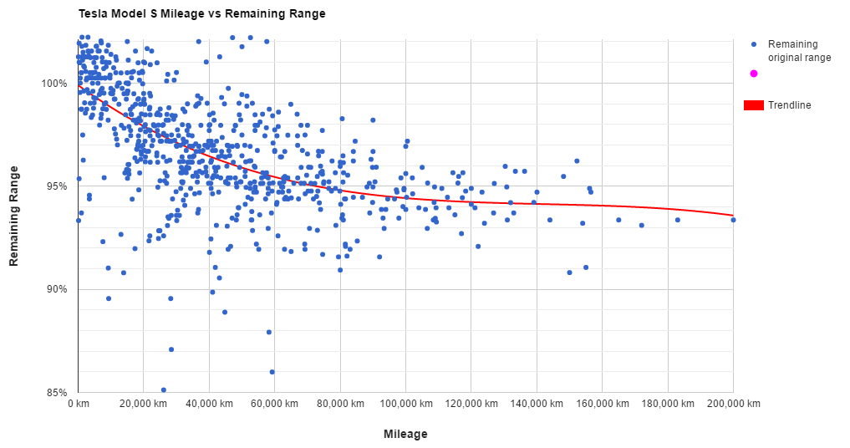
Tesla batteries cell aging
… after
800 000 km
still have
80% capacity

Slide 28
Tesla Roadster 2
200kWh
Dojezd 1000km
0-100km/h : 1,9s

Slide 29
Tesla Semi – range 650 – 800km

Slide 30
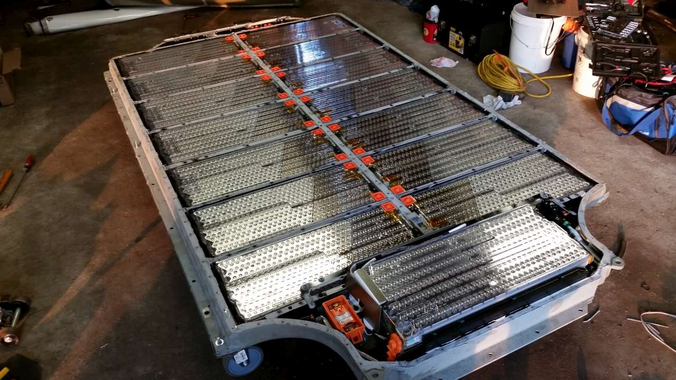

Slide 31
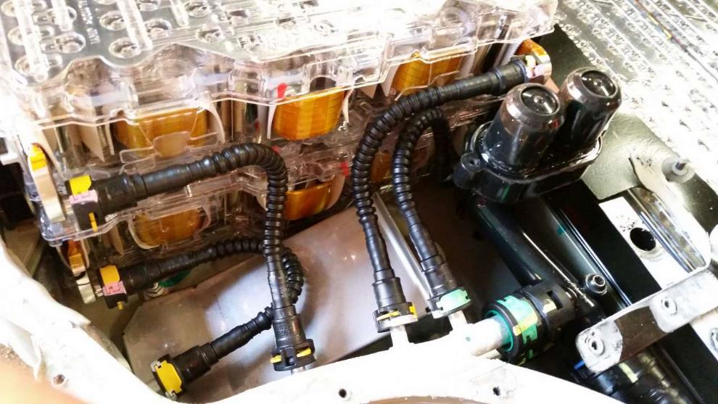
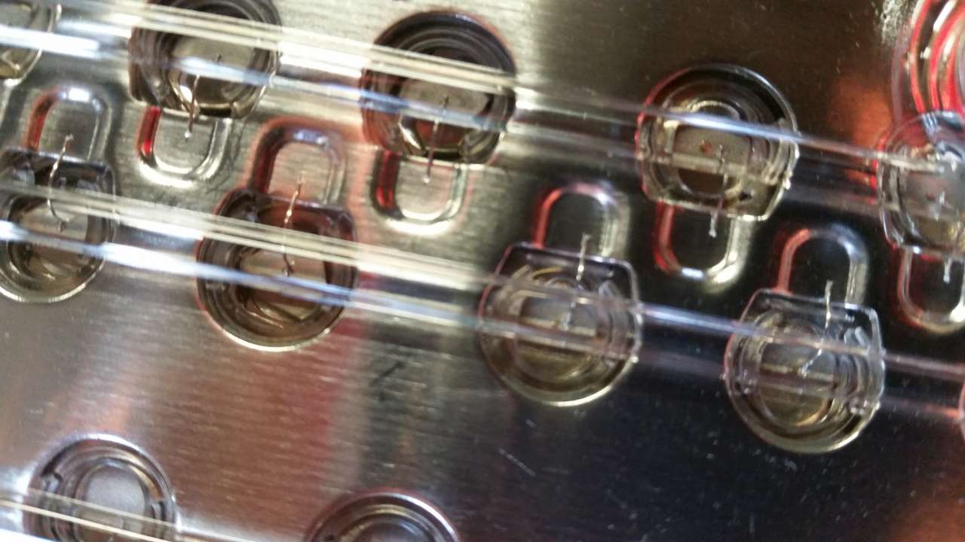

Slide 32
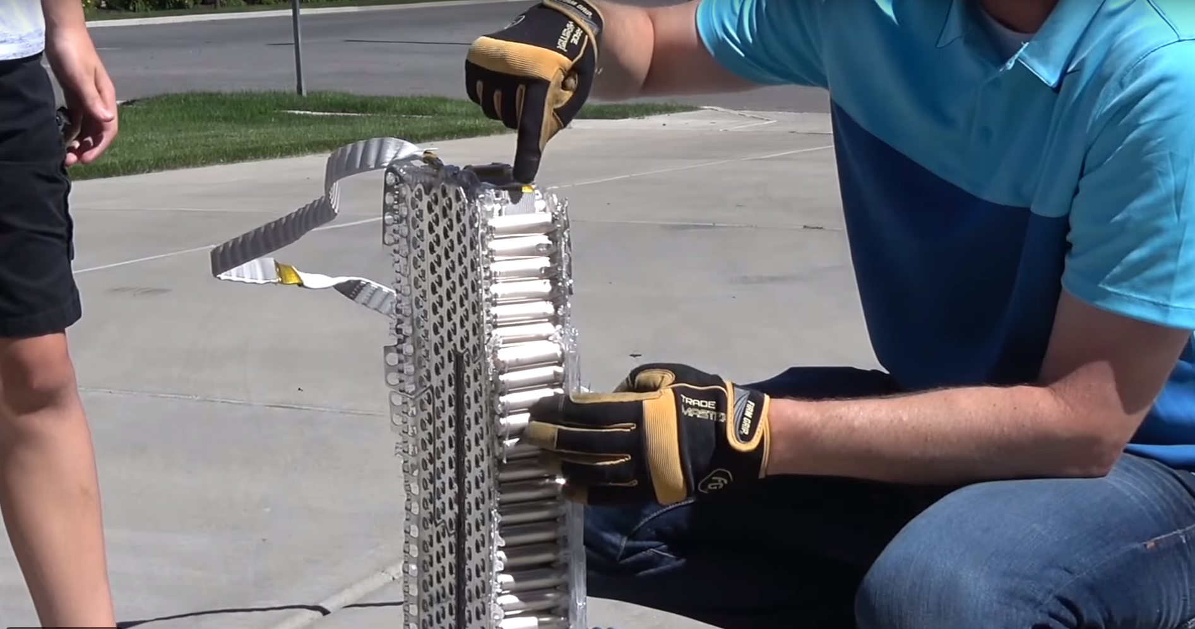
Inside Tesla Cell 18650 – alu cooling strip

Slide 33
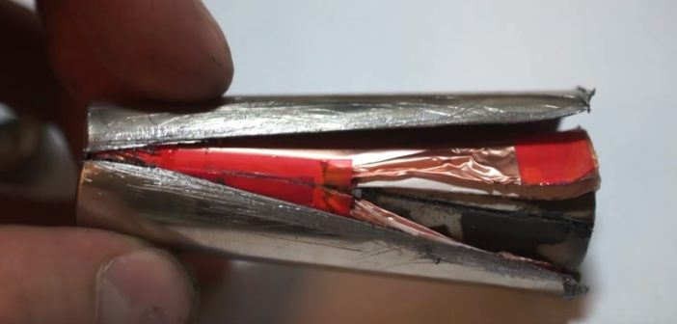
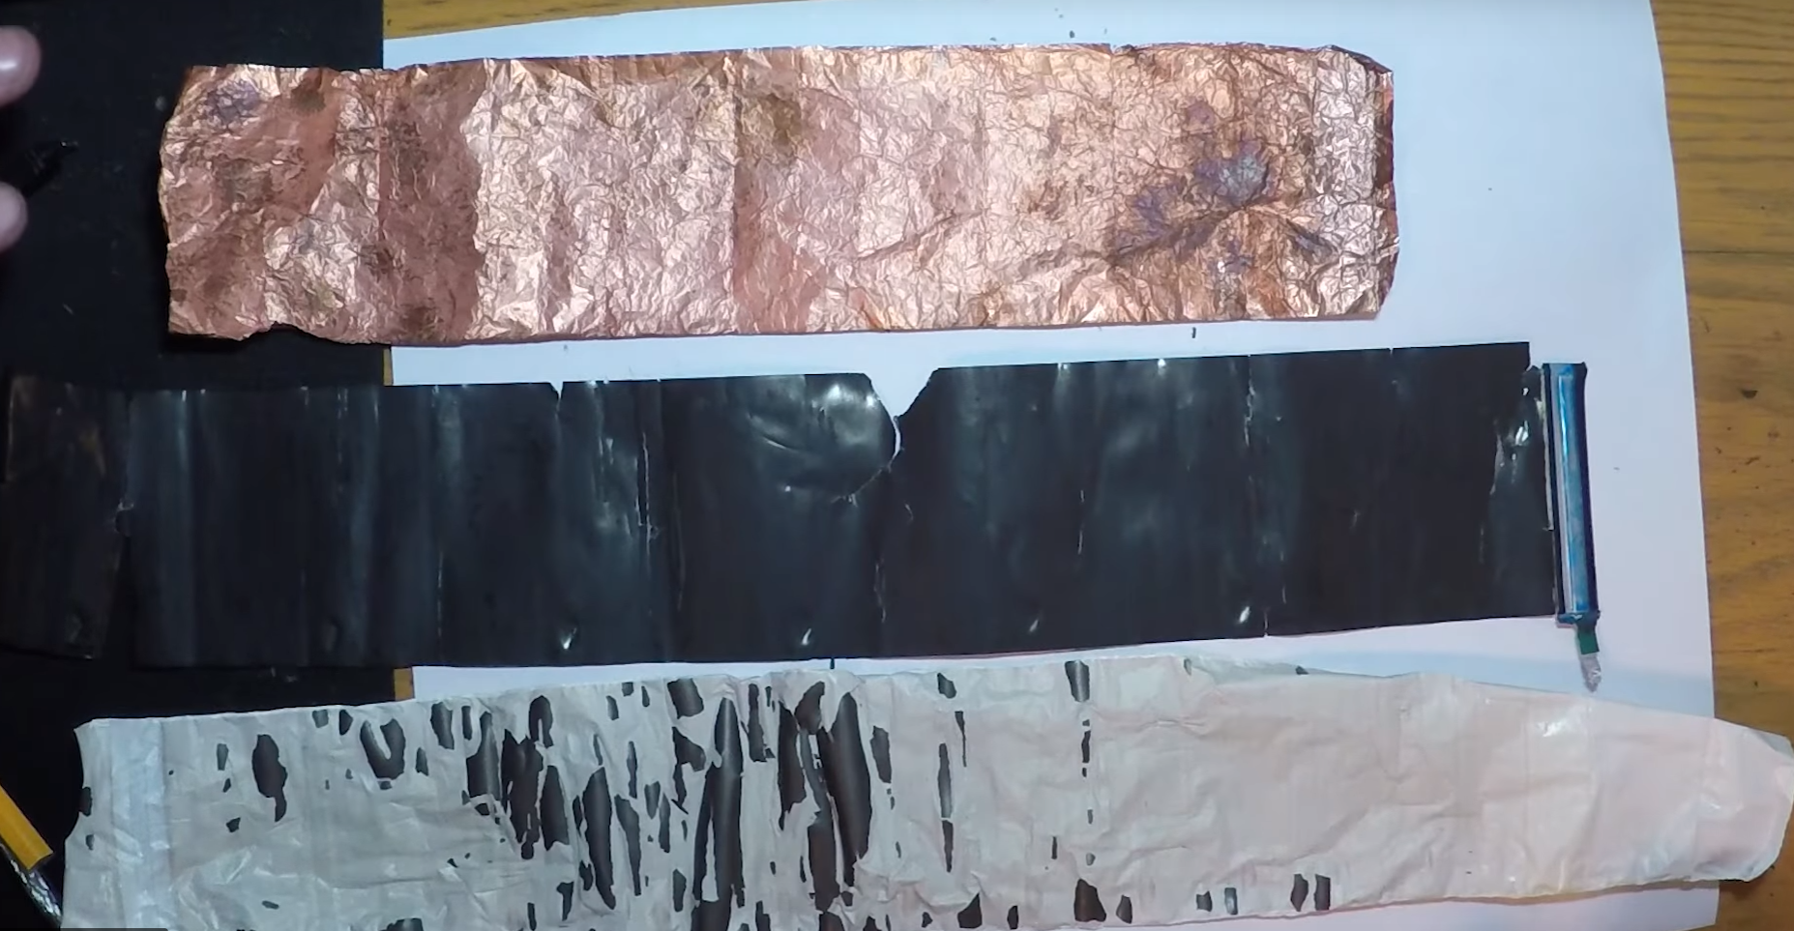

Inside Tesla Cell 18650 – 18 mm x 65 mm

Slide 34
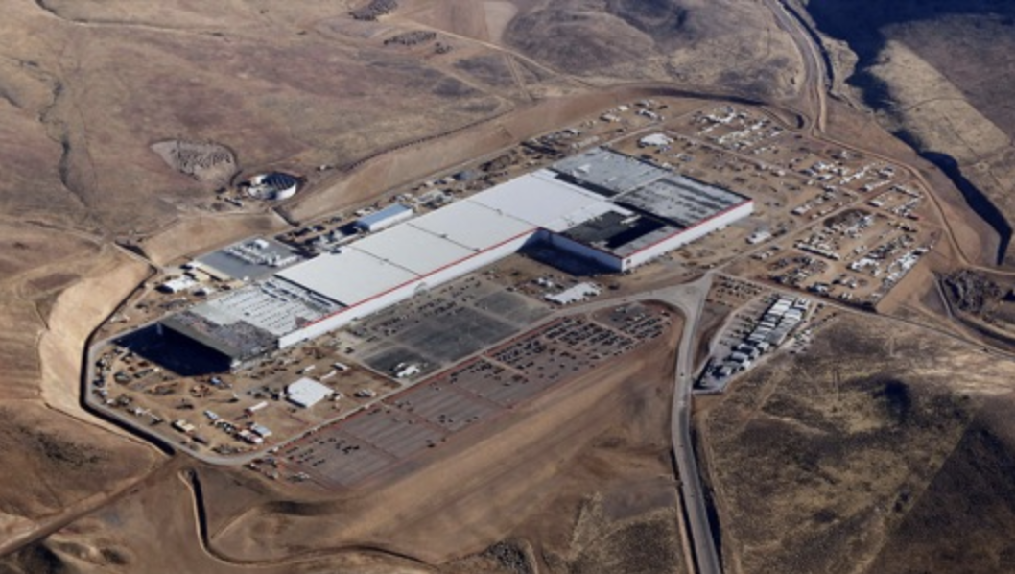
Tesla Model 3 battery pack
GIGA FACTORY

Slide 35
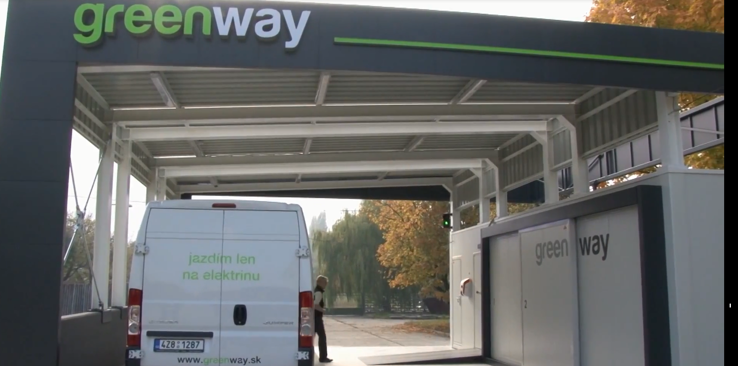
Electric van from EVC Hulin

Slide 36
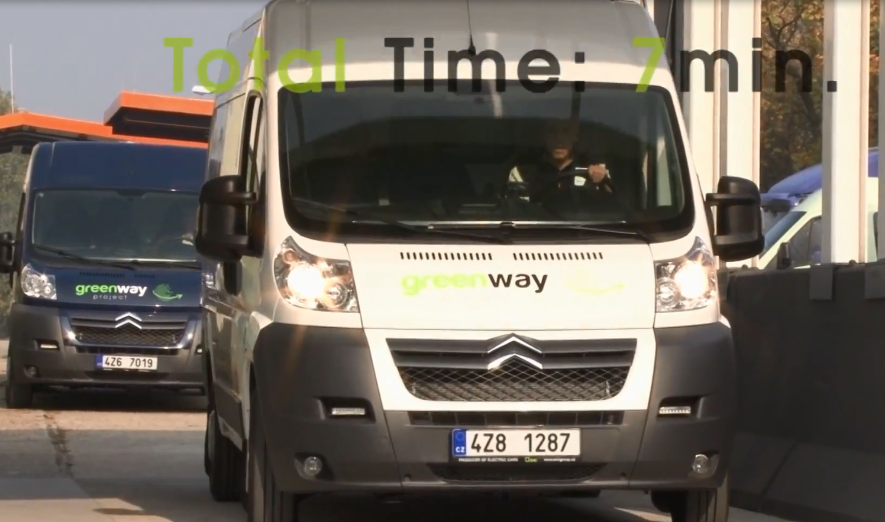
Speed battery change

Slide 37
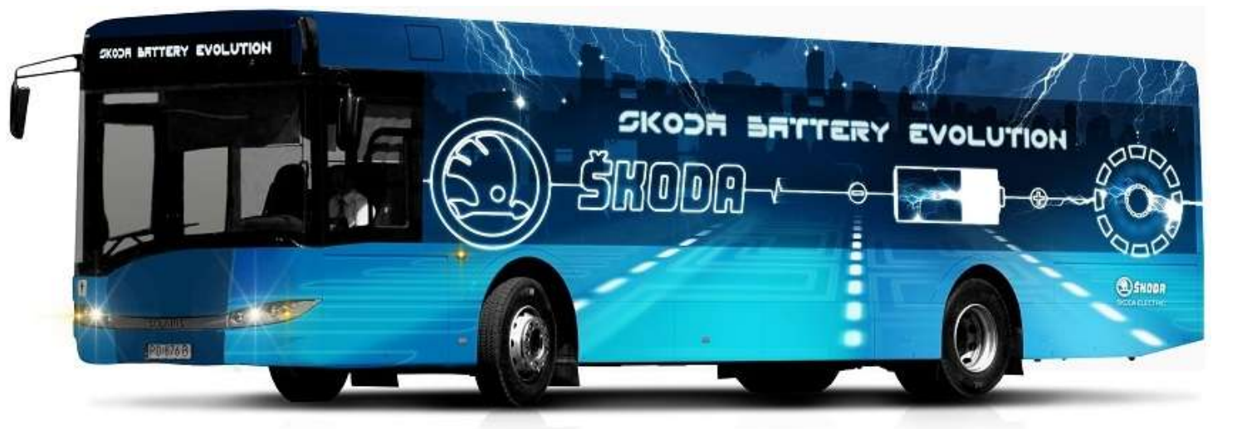
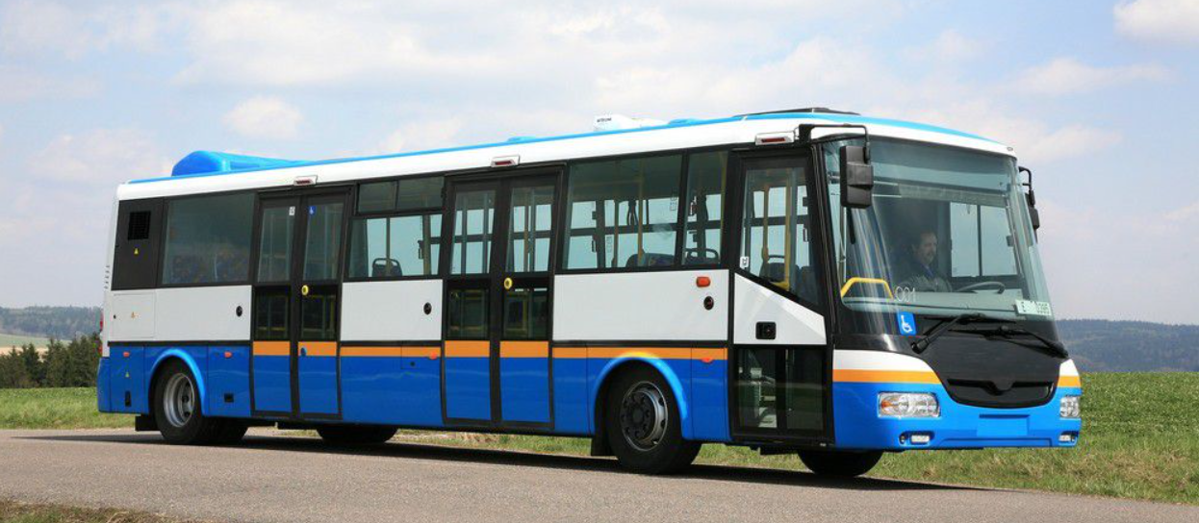
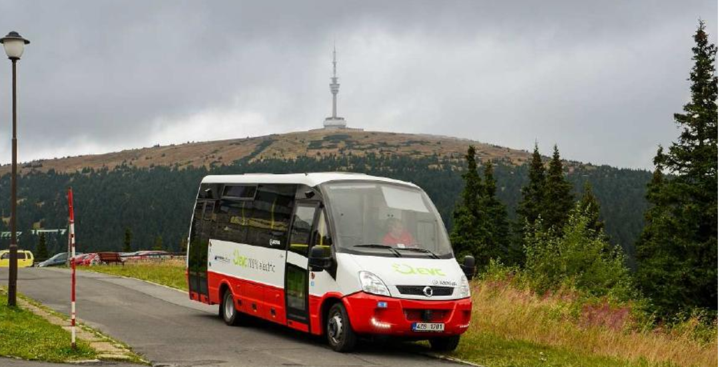
Czech electric buses
EVC Group Hulín - EVC First Electric
SOR Libchavy – EBM 10,5 a EBM 8 (Baterie EVC group)
Škoda Electric Plzeň – Perun 12m

Slide 38
