Slide 1
UK National Programme Update:
June 2018
Francesca Iudicello - Programme Manager - Automotive

Slide 2

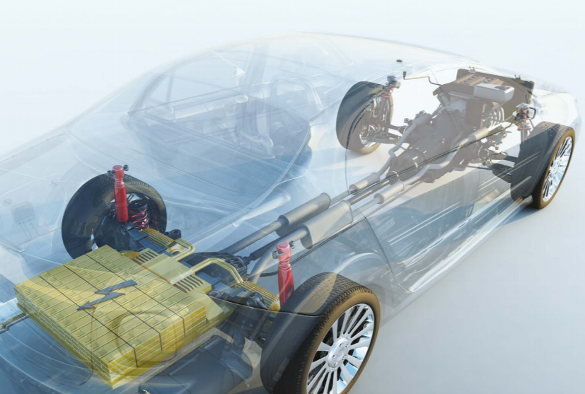
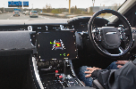


Priority Areas in Automotive Innovation
Low/Zero
Emission Vehicles
CAV
R&D funding to position the UK at the forefront of CAV research, development testing and use:
+70 projects
+£100m project value
+300 organisations
Since 2007 we have supported:
+320 projects
468 organisations
£600m project value
On vehicle technologies
Vehicle Charging
Battery Innovation
Investment in UK’s capability in vehicle charging:
£30m Vehicle to Grid competition
£40m (2018) supporting On-street and Wireless charging
Faraday Battery Challenge supporting battery technologies that can be exploited at scale in the UK and globally:
3 R&D competitions
+£80m project value
Notes:
Our Low/Zero Emission Innovation platform has, since 2007 supported over 320 projects, involving 468 organisations at a project value of £600million. A complete cross section of vehicle types are included from conventional passenger vehicles, heavy goods vehicles, motorbikes, off-road vehicles to niche and high end sport cars. The on-vehicle technologies routinely supported include electric machines, power electronics, energy storage, energy management, light weighting, powertrain structures and other highly disruptive zero emission technologies.
Another area and in support of zero emission vehicles is our investment in research and development for vehicle charging infrastructure. This is exemplified by our recent £30m Vehicle to Grid competition and the announcement of £40m of funding in 2018 to further develop the UK’s capability in charging technology.
Another major area for Innovate UK is Connected and Autonomous Vehicles (CAV) which has seen significant growth over the last few years thanks to the £250 million in funding by the Government’s Centre for Connected and Autonomous Vehicles (CCAV).
We are also linked to world leading progress on the development of batteries through the Faraday Battery Challenge. This is an initial £246million pound investment to fund research, innovation and scale-up facilities for batteries. As a part of this Innovate UK routinely run R&D competitions to overcome the technical and/or commercial challenges in battery innovation, development and manufacture. The projects supported via Innovate UK are leading to battery technologies that can be exploited at scale by the automotive sector in the UK and globally.
Innovate UK will continue to evolve to guarantee that our funding is supporting, the right technologies for the greatest return, the UK as a centre of automotive excellence and a strong, globally attractive destination for innovation.

Slide 3



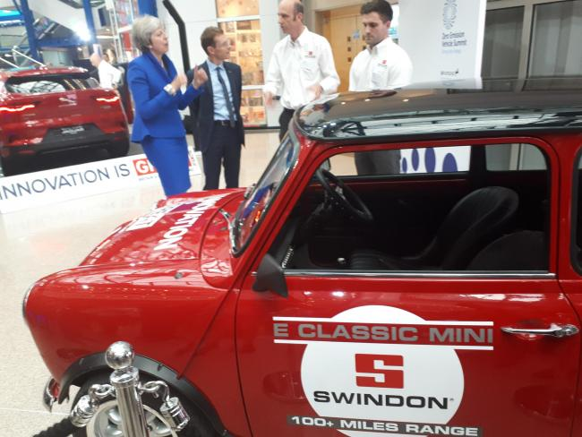
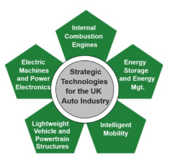
The Road to Zero Emission Vehicles
Ambitions
At least 50%, and as many as 70%, of new car sales and up to 40% of new van sales being ultra low emission by 2030
Set an ambition for a UK content target for the ultra low emission vehicle supply chain – building on the Sector Deal (50%)
Launch a new supply chain competitiveness and productivity improvement programme
I have set this country an ambitious mission. To put the UK at the forefront of the design and manufacturing of zero-emission vehicles and for all new cars and vans to be, effectively, zero emission by 2040.
Prime Minister Theresa May - Sept 2018
Integrated Delivery Programme IDP15 - The Road to Zero emission vehicles - £24.5 million multi strand competition funded by OLEV:
Electric machines and power electronics
Energy storage and energy management
Lightweight vehicle and powertrain structures
Highly disruptive zero emission technologies
Dealt with separately
Notes:
In particular, the road to zero industrial strategy sets some ambitious targets for new car and vans sales by 2030 (50% ultra low emission). It also sets an ambition for the supply chain for ultra low emission vehicles.
IDP15 is aligned with latest “the road to zero” industrial strategy for low emission by building up on previous competitions.
The programme competition is aiming at funding TRL3 to TRL6 projects in Low emission vehicle platform and is funded by OLEV.
Tactically guided by three (four) of the five sticky technologies (plus disruptive technologies

Slide 4
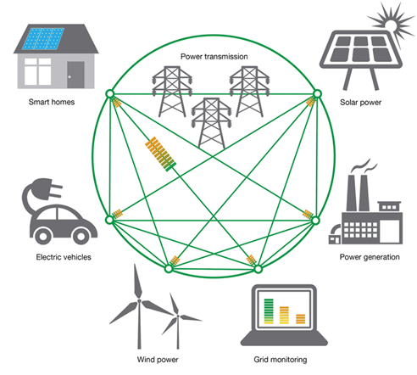
Vehicle Charging: EV-grid integration & V2G
Interaction with the Electricity Grid: availability of a widespread accessible Charging Network is needed for EV uptake
Vehicle-Grid integration - Uncontrolled charging can be disruptive for the Electricity Network: V2G aims at integrating EVs as Grid resource and allowing energy exchange from vehicle to Grid
Innovate UK V2G competition awarded £30m in 3 key areas:
Feasibility Studies
Collaborative R&D
Real-world demo
  Demonstration of reliable business cases for V2G in UK
  Development of affordable hardware
  Development of aggregation platforms
  Evaluation of long term battery life for combined transport and V2G use cases
  User engagement – EV owners need to ‘buy-in’ the V2G technology and operations
8 projects explore feasibility of innovative business models for V2G
5 projects will develop V2G HW and aggregation platforms in the UK, creating an integrated V2G supply chain
8 projects will trial more than 2700 vehicles in V2G operation, covering different customer types, geographical areas and customer propositions
Notes:
Charging could become the rate limiting step – needed to be addressed.
The transition from the 100,000s EV currently up to the millions would put an incredible strain on the grid. We need to be working to make sure the charging of Vehicles is done in a flexible, safe and responsible way in terms of its impact on the grid.
With this came the first of its kind v2g comp. It looked to integrate EVs as a Grid resource while bringing two distinct industries together in the Energy and Auto sectors to solve a common issue.

Slide 5


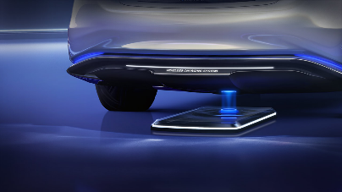
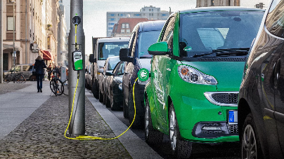
Developing the EV Charging Infrastructure
Most of EV charging happens at home, but less than 40% of people have access to
off-street parking: crucial to EV uptake, specially in urban centres,
is an accessible, affordable and dependable charging infrastructure
Investing £40m innovation funding in 2018 in:
Wireless EV Charging for Taxis and Light Commercial vehicles
Electrification of on-street parking
In urban centres, major contributors to pollution are Taxis and Light commercial vehicles
Widespread EV adoption is hindered in urban centres by availability of off-street parking space (<40%)
Shifting these to EVs improves air quality, but issue of business downtime when charging needs to be addressed:
Wireless Charging would allow to top up battery when at taxi ranks or delivery bay
Innovation funding towards a Urban Design Challenge to electrify on-street parking in a low-cost, easily deployable and accessible fashion intends to fix this
Notes:
Continuing the theme of addressing charging capability.
£40m spread across two competitions
Wireless charging (taxis and commercial) and Electrification of on street parking.

Slide 6



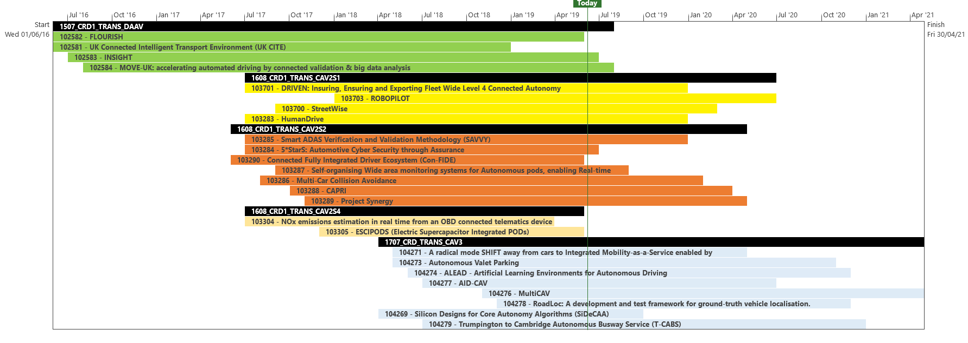



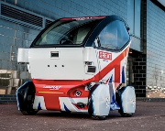


Connected and Autonomous Vehicles (CAV)
Projects ~70
Total funding £100m
Organisations 276
Includes project unique to UK: Quantifying Weather Extremes For AV Sensor Specifications
CR&D Projects

Slide 7
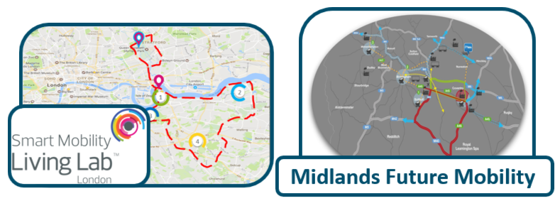
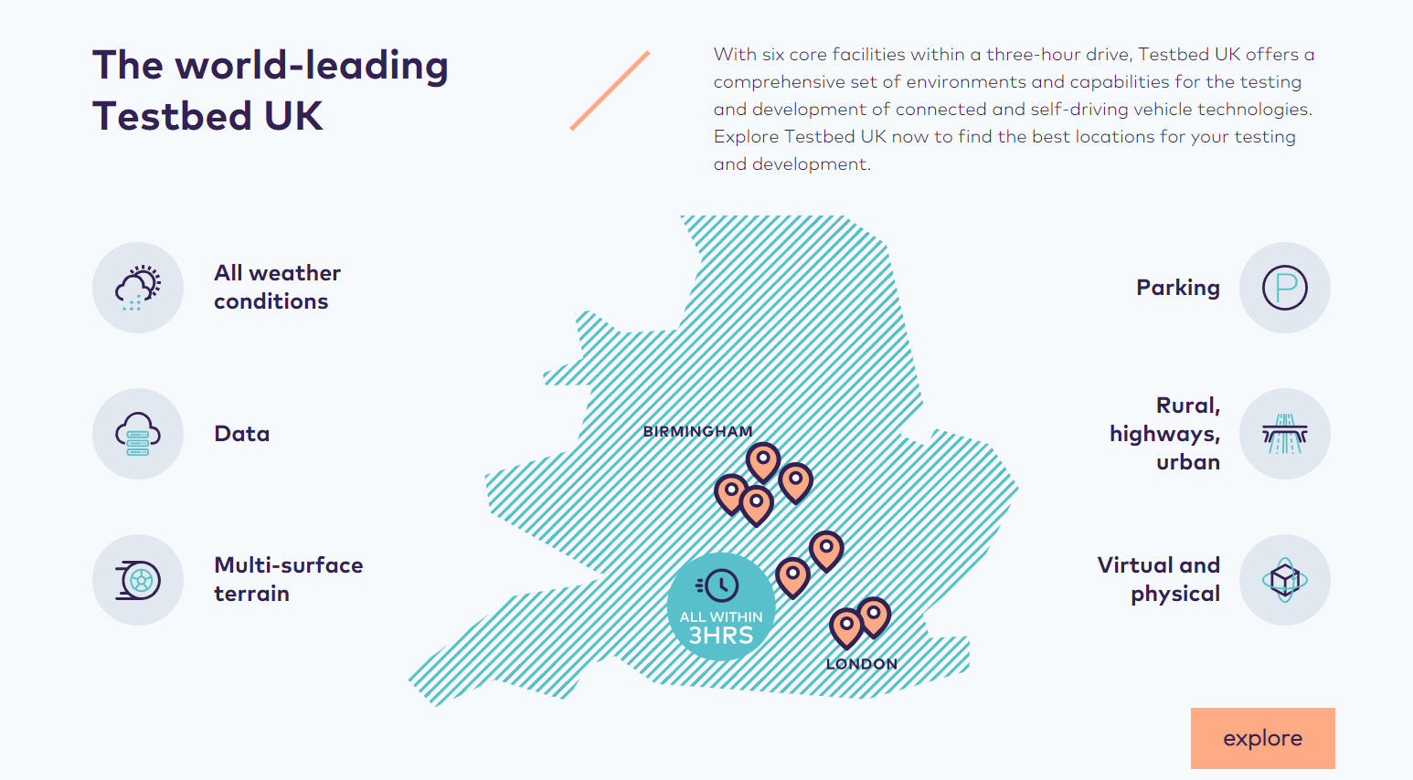
CAV Test Beds
Public Road:
- Smart Mobility Living Lab (Greenwich & Olympic Park)
- Midlands Future Mobility (Warwick, Cov., B'ham)
Secure Track Facilities:
- TIC-IT: extreme handling facility (Horiba MIRA,
Nuneaton)
- MCTEE: City circuit (Millbrook, Bedfordshire)
- CAVWAY: Highway Junctions (Bruntingthorpe,
Northants)
- PARK-IT: Car parking test facility (Horiba MIRA,
Nuneaton)
Semi-controlled Facility:
- MCTEE: campus type at RACE (Culham, Oxfordshire)
Data Platform Facility:
- ConVEX: Cloud based, led by Bosch

Slide 8


ISCF Faraday Battery Challenge
i
£274 million (2017-2021)
Advisory Group, Programme Board
Challenge Director
&
&
Research: £78m
Innovate: £88m
Scale: £108m
‘Application-inspired’ research programme coordinated at national scale
Creation of the Faraday Institution –responsible for coordination of research and training programmes
Four ‘fast-start’ projects announced Jan 2018 (£42m) – Battery Degradation, Multi-scale Modelling, Recycling, Solid State Batteries
Round 2 call for proposals launched Jan 2019 - £12m/year available for: Next generation Li-ion cathodes, Electrode manufacturing; Next generation Na-ion batteries; Beyond Li-ion
Innovation programme to support business-led collaborative R&D with co-investment from industry
Address technical challenges and build UK supply chain
£38 million committed in Round 1 (2017) to Collaborative R&D and Feasibility Study projects– projects addressing range of areas from cell materials to pack integration and BMS to recycling
£22 million Round 2 to 12 CR&D and Feasibility Study projects announced in June 2018
Round 3 announced June 2019 with £23 million awarded to 25 CR&D and Feasibility Study projects.
Scale up programme to allow companies of all sizes to rapidly move new battery technologies to market
Develop manufacturing tools and methods for mass production
Demonstrate production-rate reliability and quality
CWLEP & WMG building open-access scale up facility: UK Battery Industrialisation Centre
Construction of the building well underway. Open March 2020.

Slide 9
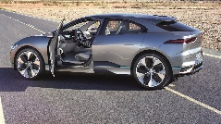


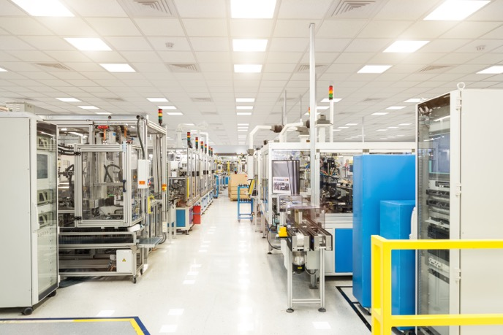





ISCF Driving the Electric Revolution (DER):
Power Electronics, Machines and Drives
High Efficiency, High Volume Supply Chains - Focus on 2025 target to build £5bn additional PEMD products
Low Volume, High Value Supply Chains
Tier N development
Focused across all Sectors
Maximise productivity
Enable cross fertilisation
Secure sufficient capacity
Materials to Manufacturing
Covering full PEMD lifecycle from new materials to manufacturing
Driving innovation beyond our international competitors
Supply Chain Development
Build new supply chain to support increase in electrification demand
Build UK SME’s into credible Tier 1s and Tier 2s
Developing World Leading Facilities
Prototyping and Scale-Up
Consolidating international leadership in UK academic base
Training and Skills
Meeting industry requirements for PEMD specialists
Retraining, technical and dedicated PEMD degree programmes

Slide 10
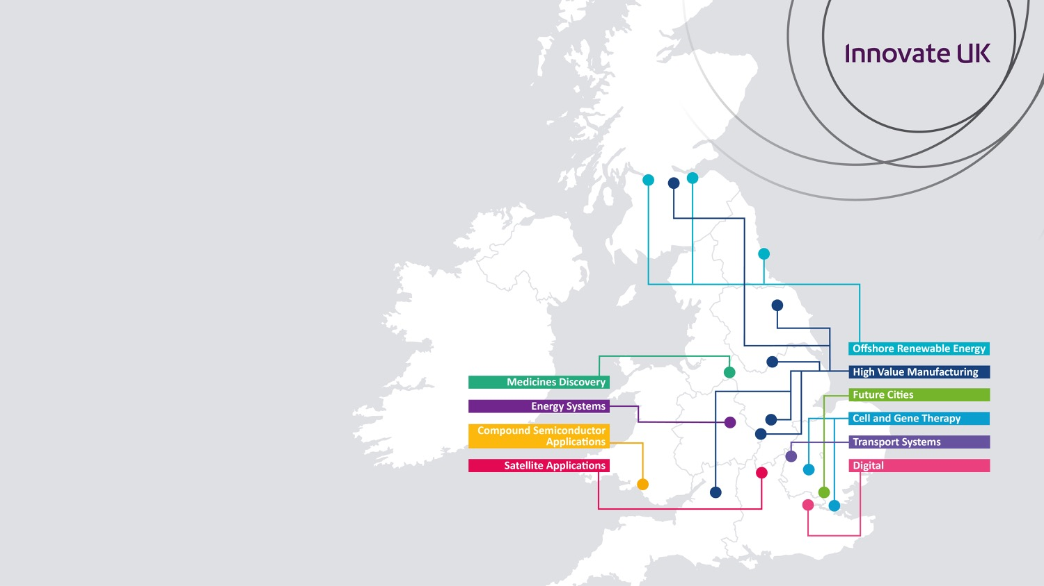
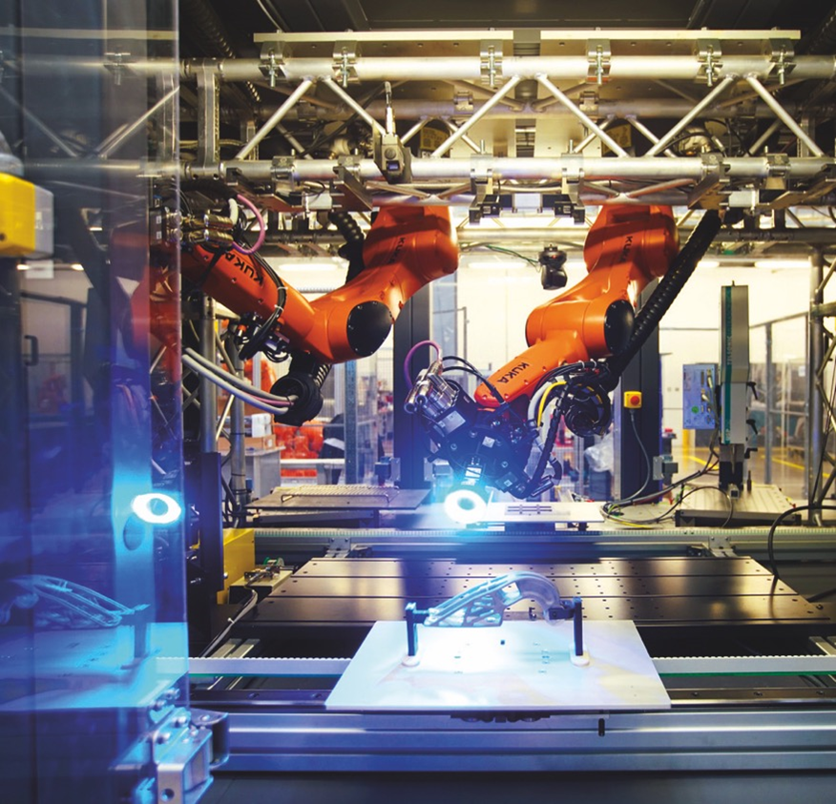

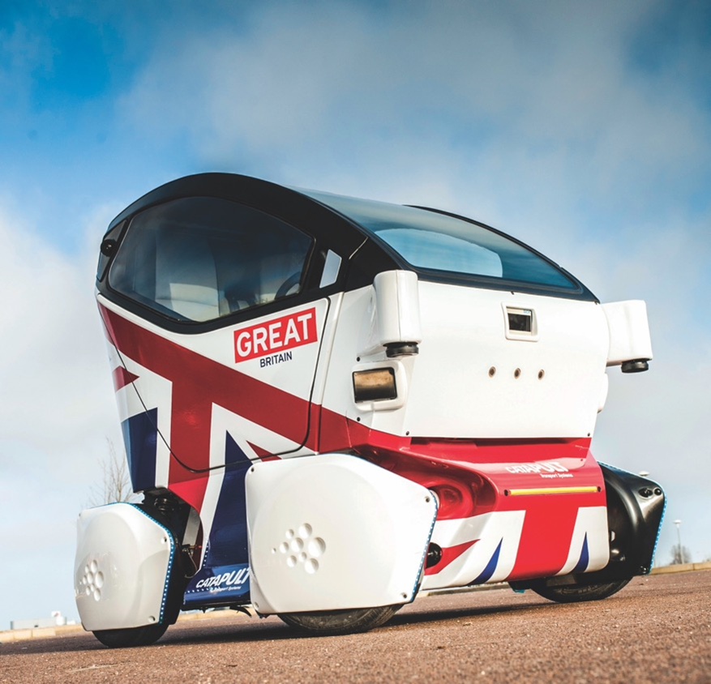



Catapult Centres
established and overseen by Innovate UK
part of a network of technology and innovation centres
bridge the gap between businesses, academia, research and government
Connected Places
Notes:
Connected Places Catapult
Promoting economic growth and wellbeing through integrated, efficient and sustainable transport systems in the UK.
focus on mobility as a service, connected & autonomous vehicles and data
modal integration and more effective use of available capacity
innovation centre in Milton Keynes
close working relationship with the Department for Transport
Compound Semiconductor Applications Catapult
Helping the UK become a global leader in developing and commercialising new applications for compound semiconductors
helping UK companies exploit advances in compound semiconductor technologies
part of the world’s first compound semiconductor cluster in south Wales
providing business opportunities for power electronics, RF/microwave and photonics
part of CS-Connected, alongside the Institute for Compound Semiconductors and the Compound Semiconductor Centre
High Value Manufacturing Catapult
The go-to place for manufacturing technology innovation in the UK.
7 centres working with industry, academia and government
bringing the best research to market
access to industrial-scale facilities and engineers, scientists and technicians
help with manufacturing capabilities: raw materials, product development, optimisation and automation

Slide 11
To come in 2019…
Integrated Delivery Programme IDP16 – mid TRL innovation - £xxm TBC
APC12 - £20m, APC13 - £25m
EV charging/infrastructure (V2G and Smart Charging) - £40m to 55m
CAV Sim - £25m, CAV4 - £25m, CAV Test Bed2 - £25m
Faraday Challenge – Batteries for vehicle electrification - £xxm TBC
DER – £xxm TBC

