Slide 1

Memberstate meeting Brno
The new latest activities in your country about road transport research funding.
Annelie Nylander Trafikverket, Sweden

Slide 2
Outbound freight flows

Slide 3
Inbound freight flows

Slide 4
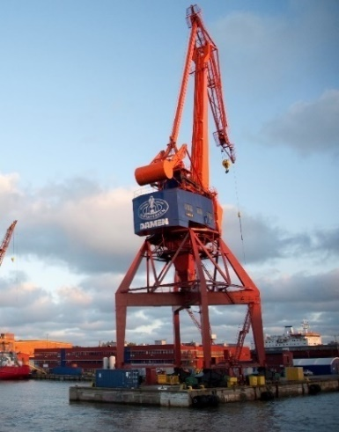
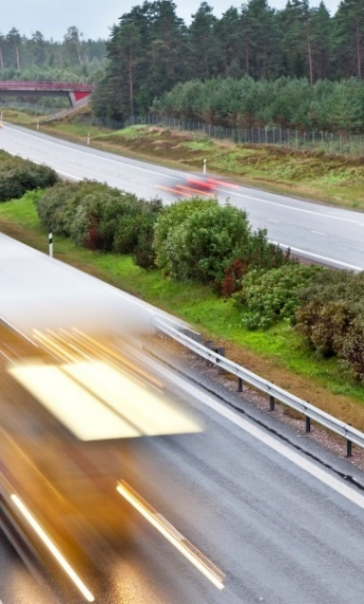
Efficient, high-capacity and sustainable freight transport – a national freight transport strategy
First strategy of its kind in Sweden
Covers all modes of transport
Contributes to
  Achieving the national transport policy objectives
  Strengthening the competitiveness of business
  Promoting modal shift from road to rail and shipping
Platform for collaboration in the freight area

Slide 5
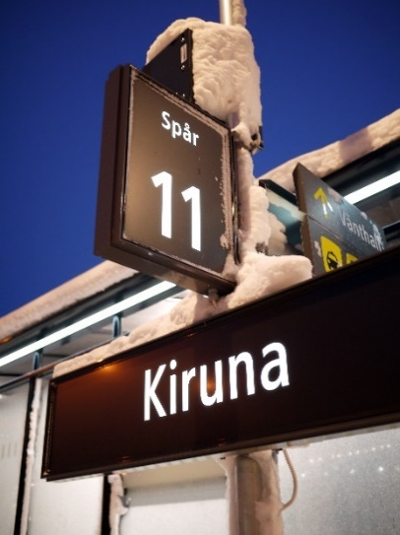
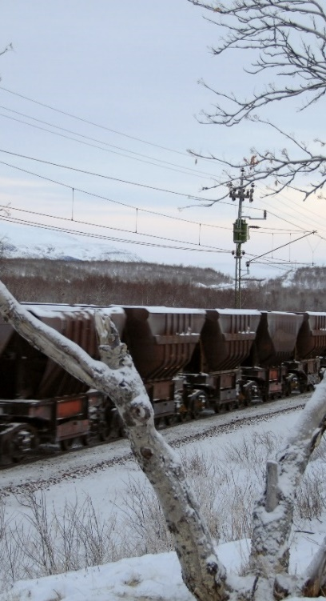
Main themes of the strategy
Competitive and sustainable freight transports
Transition to fossil-free freight transports
Innovation, skills and knowledge

Slide 6

Vehicle strategic research and innovation (FFI)
Vehicle strategic research and innovation (FFI) finances research and development activities for approximately SEK 1 billion per year. Overall goal is to:
-Reduce the environmental impact of road transport
-Reduce the number of injured and killed in traffic
-Strengthen international competitiveness
https://www.vinnova.se/m/fordonsstrategisk-forskning-och-innovation/om-ffi2/
Notes:
State funding accounts for half of this. Cooperation is important because the development in road transport and the Swedish automotive industry is of great importance for sustainable growth in Sweden. FFI's overall goal is to: Reduce the environmental impact of road transport Reduce the number of injured and killed in traffic Strengthen international competitiveness FFI's activities focus on climate, environment and safety. The business is divided into five permanent areas - sub-programs. These are controlled by a road map. In addition, there are shorter focus areas that are commonly called strategic initiatives and these all have their own program description.

Slide 7

Strategic plan for how the transport sector should become fossil-free – SOFT
The plan contains measures that will contribute to fulfilling the goal of reducing greenhouse gas emissions from the transport sector by at least 70 per cent between 2010 and 2030 as well as the goal of climate neutrality by 2045.
The task of producing the plan comes from the government. Six authorities have produced and cooperates regarding the plan.
http://www.energimyndigheten.se/nyhetsarkiv/2017/strategisk-plan-for-hur-transportsektorn-ska-bli-fossilfri/
Notes:
Den sammantagna bilden är att många av de aktiviteter som presenterades i den strategiska planen är i gång. Planen innehåller 29 stycken åtaganden där myndigheterna inom SOFT identifierat områden och aktiviteter som man kan jobba vidare med utan ytterligare uppdrag. Samtliga åtaganden är aktiverade och merparten av dessa löper på enligt den planering som gjorts. 31 stycken åtaganden följs upp15 och av dessa är 7 stycken slutförda.
Av de 59 förslag som presenterades i planen är 27 stycken identifierade som aktiverade. Av dessa har 7 stycken bedömts som klara och 20 stycken är pågående. Förslagen är av olika karaktär och det innebär en viss svårighet att följa upp om förslaget, som det formulerats i planen, har aktiverats eller inte. Förslagen kan ha kommit tillbaka till någon myndighet eller annan utredare som ett uppdrag från regeringen. Förslagen kan även röra andra typer av löpande uppdrag16. I andra fall kan också en aktivitet kopplat till ett förslag identifieras, men kanske inte just som det var formulerat i sin helhet i planen

Slide 8

Tripple F - fossil-free freight transportation system
Triple F is the Swedish Transport Administration's research and innovation initiative contributing to the transition to fossil free freight transport in Sweden.
Expected results are reduced CO2 emissions from freight transport according to set targets through collaboration and knowledge-building
Will be coordinated by Lindholmen Science Park
https://triplef.lindholmen.se/en

Slide 9

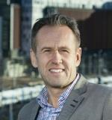
Roadmaps for fossilfree competitiveness
Based on the decision by the parliament to make Sweden climate neutral by 2045, the Fossil Free Sweden initiative has encouraged business sectors to draw up their own roadmaps as to how they will be fossil free while also increasing their competitiveness.
fossilfritt-sverige.se/roadmaps-for-fossil-free-competitiveness/
Svante Axelsson

Slide 10
Highlights:
The mining and minerals industry is carrying out an electrification and automation program that, together with a transition to biofuels, will make mining operations fossil free by 2035.
The steel industry describes a unique initiative focusing on the development of a technology to reduce iron ore to iron using hydrogen making fossil free steel possible.
The aviation industry aims to make all domestic flights fossil free 2030 and all flights originating from Sweden fossil free 2045.
The food retail sector’s goal is for all plastic packaging to be recyclable by 2022, and all plastic packages to be produced from renewable or recycled raw materials by 2030.
The road haulage industry reduced its emissions between 2010 and 2016 by 25 per cent. They will reach the goal by switching fuel and they see the potential in route optimization and digitalization.
The forest sector is aiming for fossil free industry operations 2030, fossil free vehicles in forest industries and in forestry 2030 and an increased production of biofuels based on forest raw material from 1 TWh to 10 TWh per year that will help other sectors becoming fossil free.
The construction industry aims to reduce its greenhouse gas emissions by 50 per cent (cf. 2015) 2030, 75% reduction by 2040 and have net zero emissions by 2045
The concrete industry aims to reach half the climate impact in 5 years, to have climate-neutral concrete available on the market 2030 and all concrete climate neutral 2045.
The cement industry is aiming for climate neutrality with the use of carbon capture and storage technology.
The heating sector has set the target to be fossil free by 2030, and by 2045 to become a carbon sink that will decrease the total amount of greenhouse gas emissions by using bio-energy with carbon capture and storage (BECCS) in district heating.
The maritime industry is aiming for fossil free domestic shipping by 2045 through the development of gas (LNG/LBG), battery, biodiesel (HVO) and methanol powered vessels that has already begun.
The aggregates industry is working with electrification of the machinery and also circulation of material flows to halve the emissions by 2030 (compared to 2015) and becoming fossil free by 2045.
The digitalisation consultancy industry´s roadmap shows how the sector can contribute to lower emissions from other sectors with transformative solutions.

